Slide 1
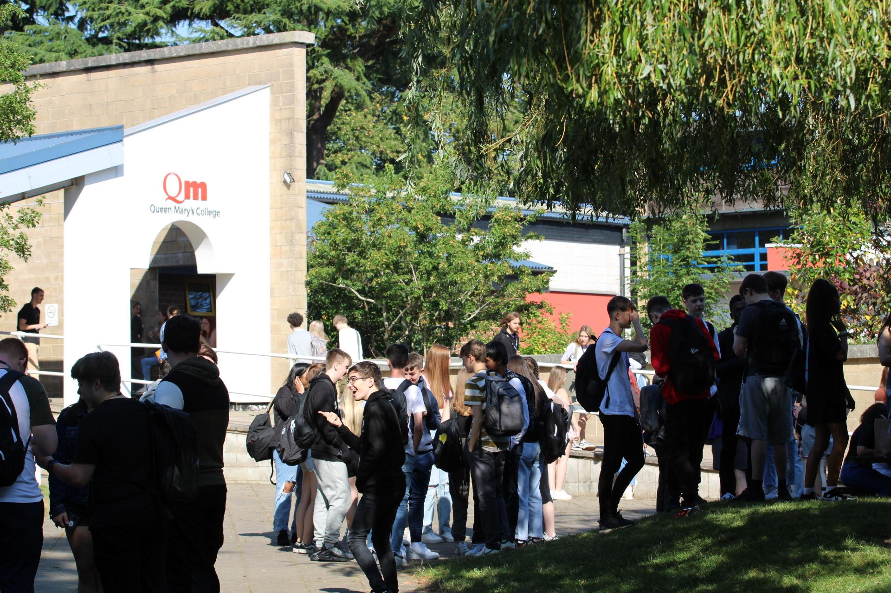
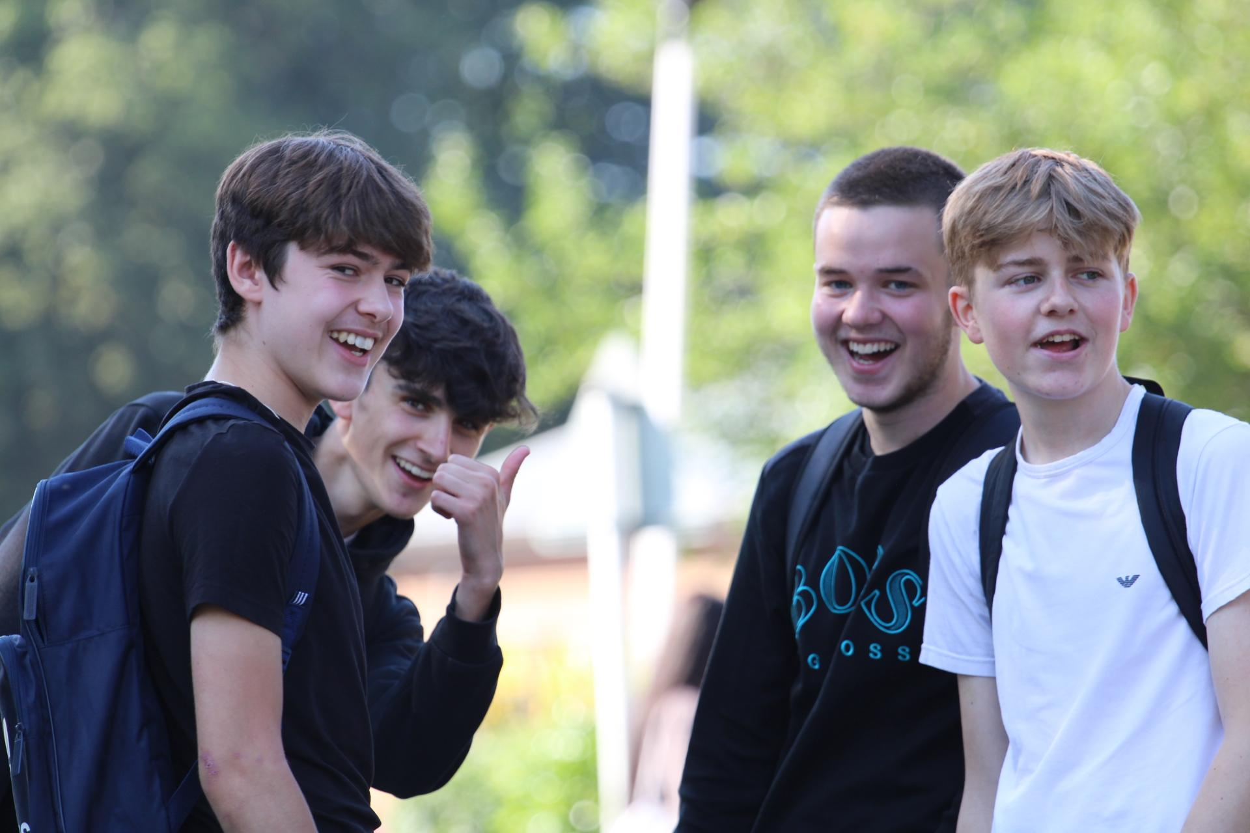
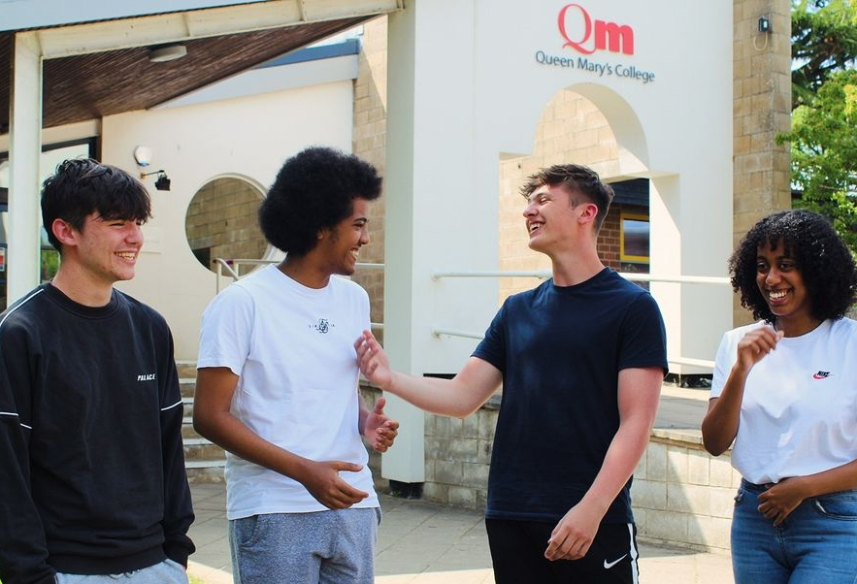
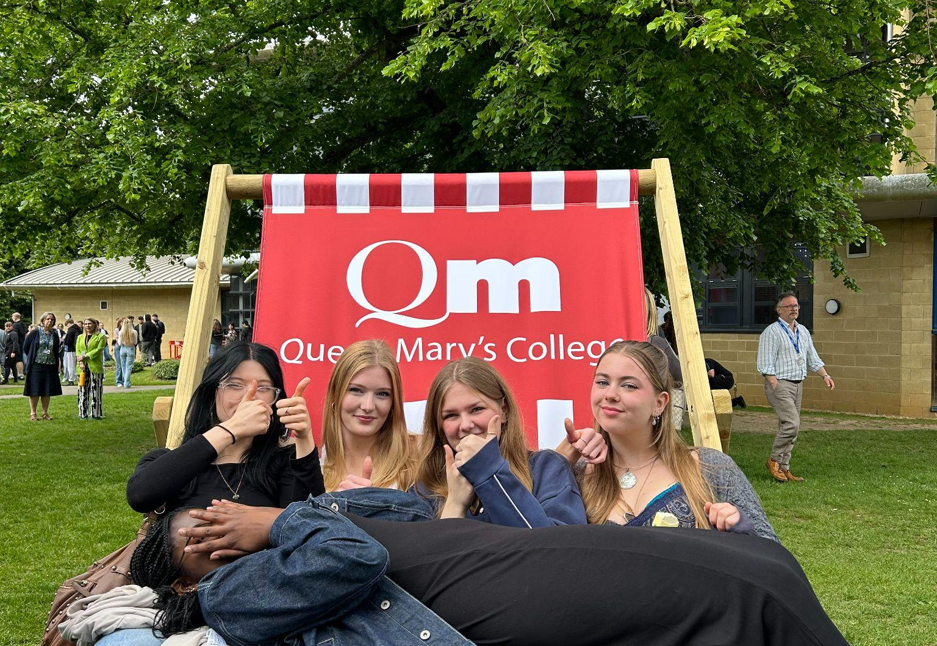
Welcome
Your journey starts here!

Slide 2
Start Thinking About Your Future Now…
What do you enjoy?
What interests you?
What are you
good at?
What do you need for your career ambitions?
Do your ideas make a sensible combination?
Are there courses that interest you that you’ve never done before?
An inclusive, vibrant and high-achieving sixth form college where students flourish

Slide 3
How to be Successful…
Be Creative…
Show initiative in approach to studies, projects, progression, development.
(Think outside the box)
Be Collaborative…
Teamwork leads to overcoming
obstacles and finding success.
Be Courageous…
Be a resilient Learner.
Overcome challenges.
Be Curious…
Show growth / excellence beyond expectation.

Slide 4
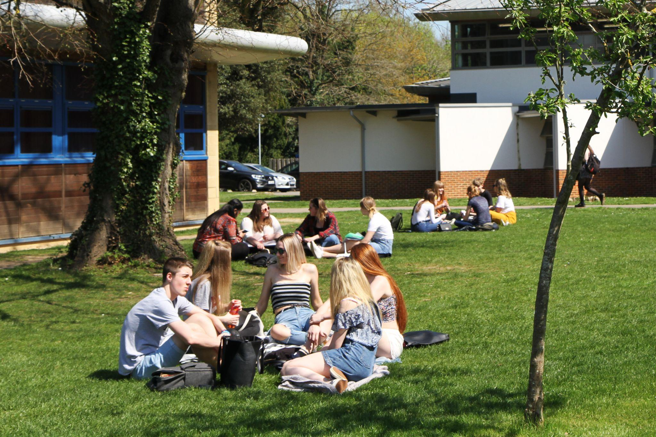
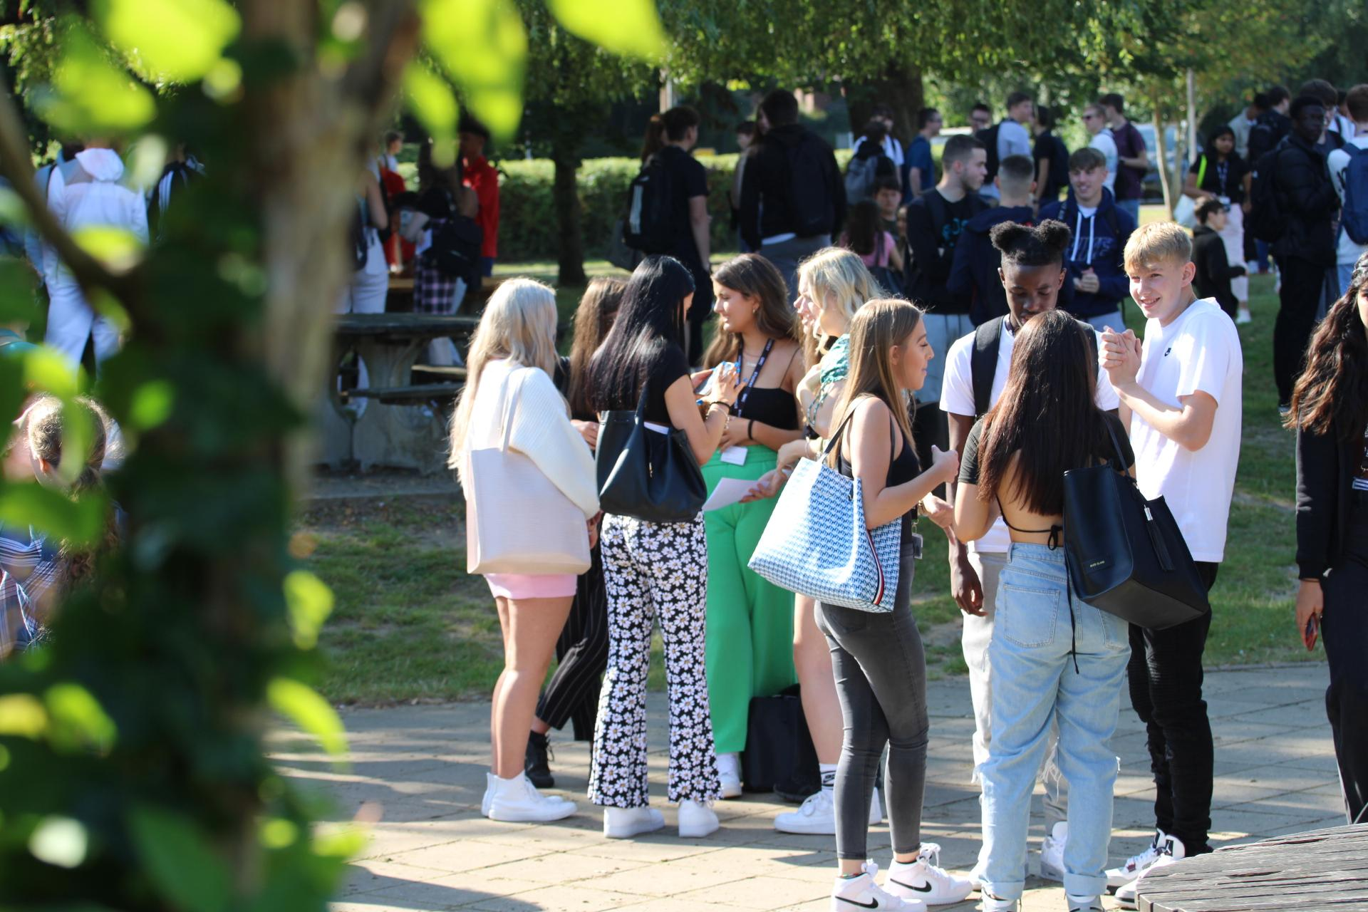
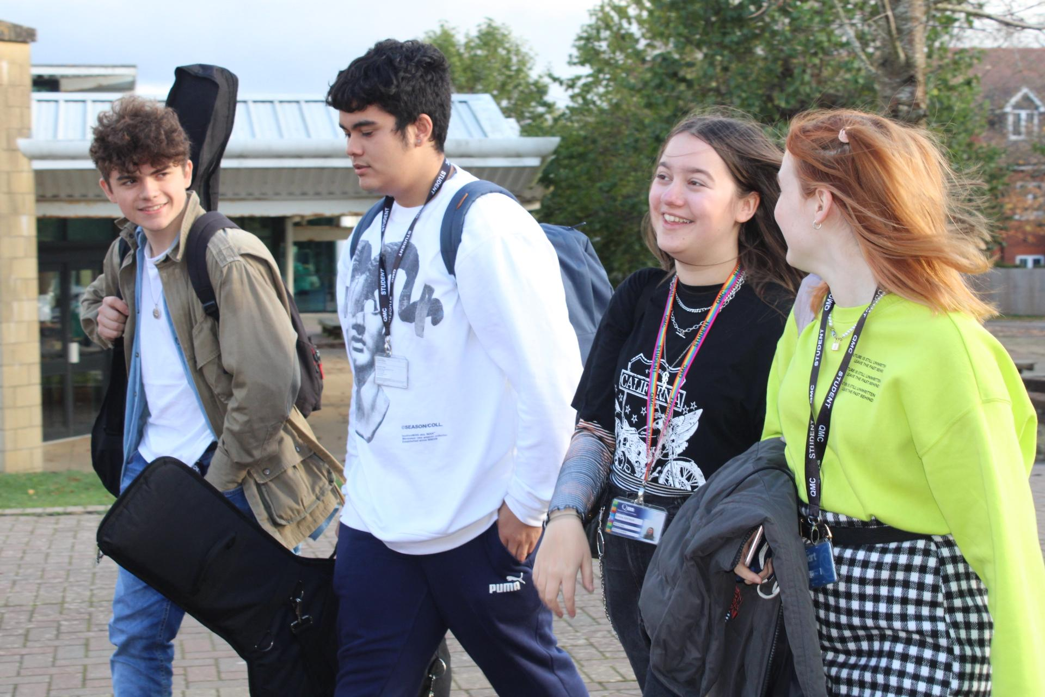
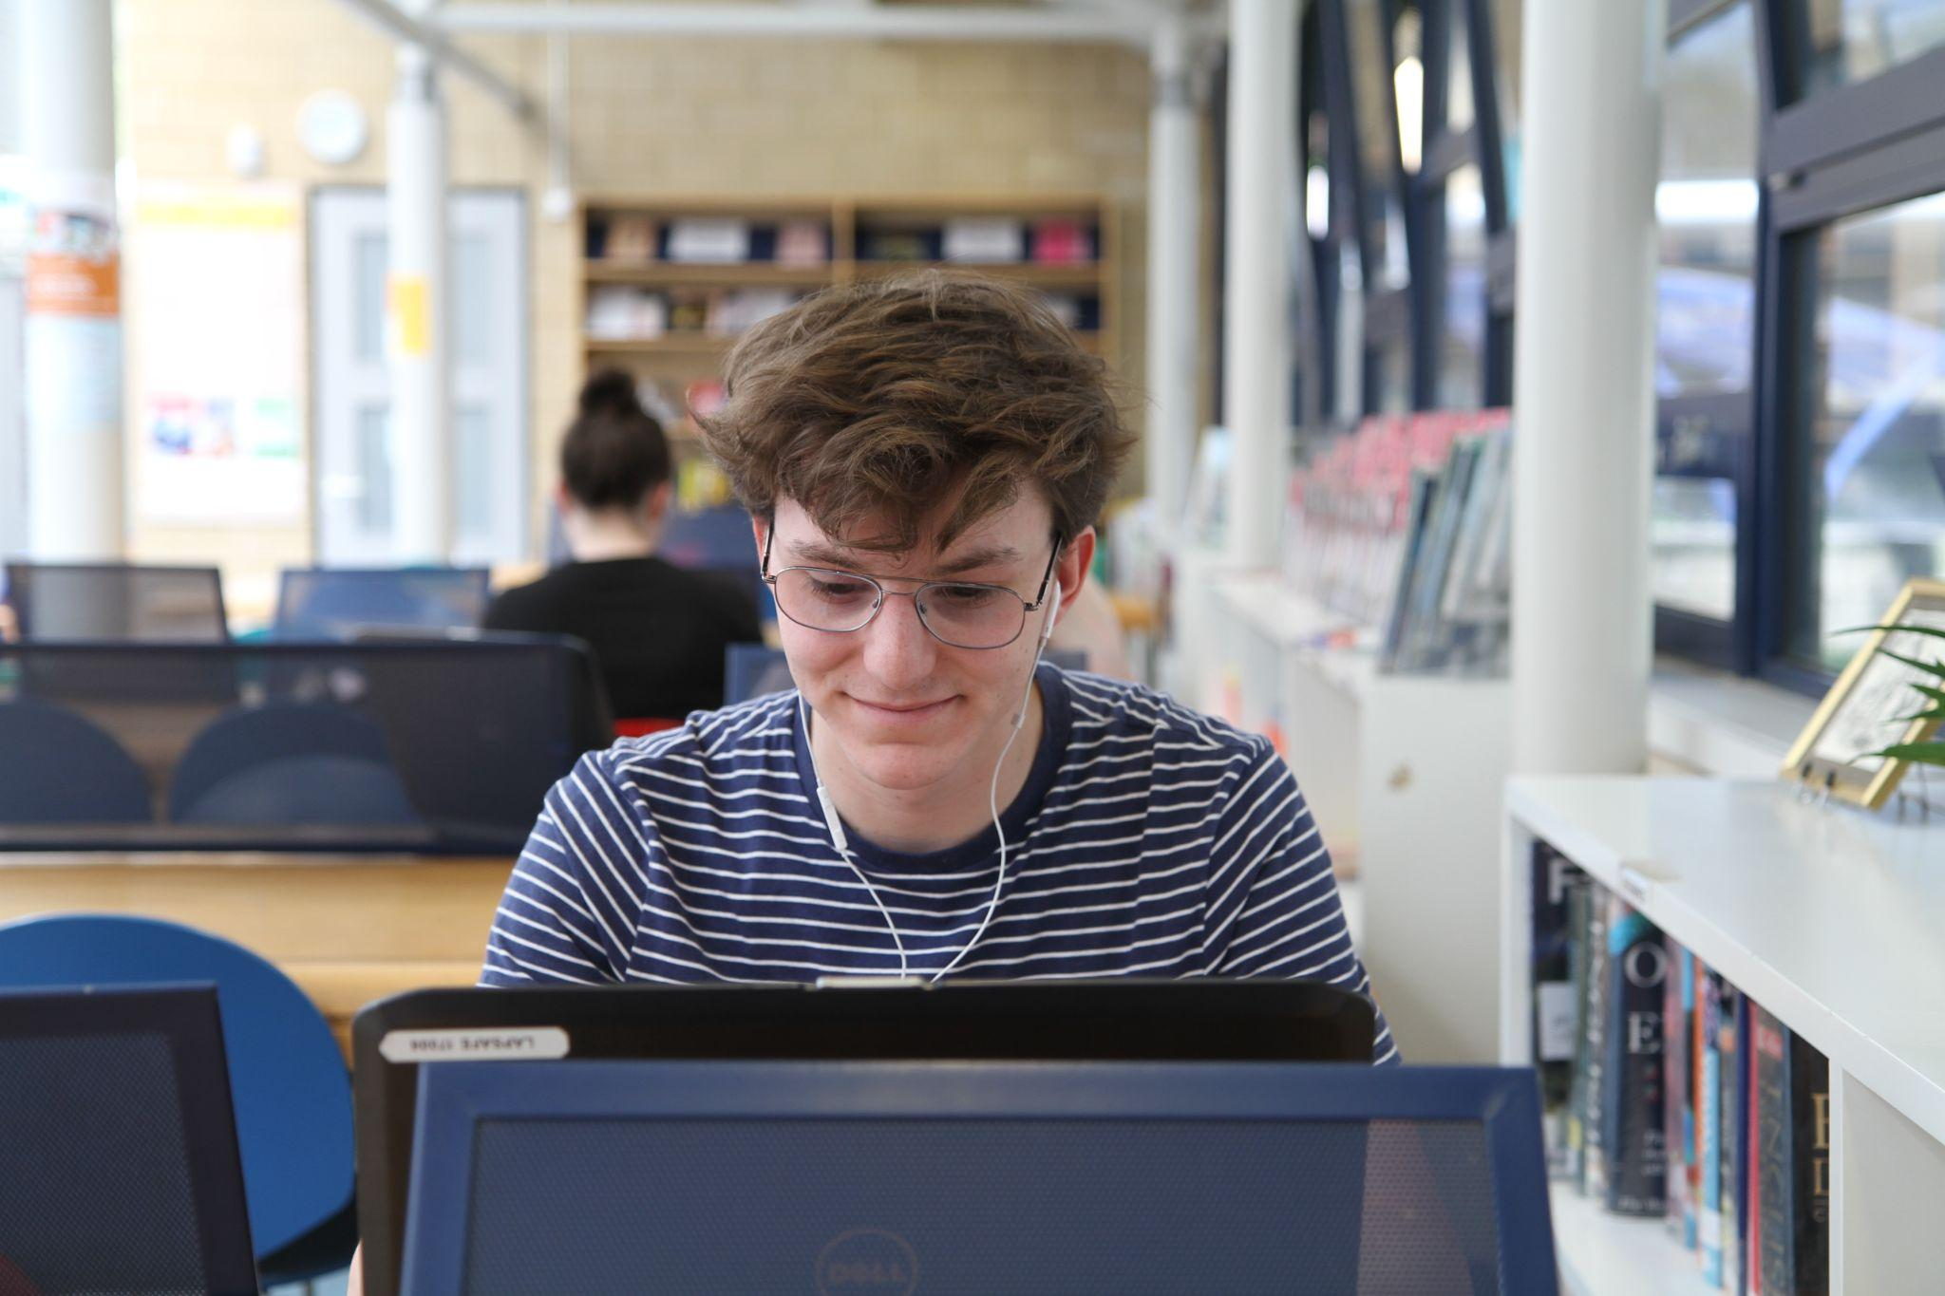
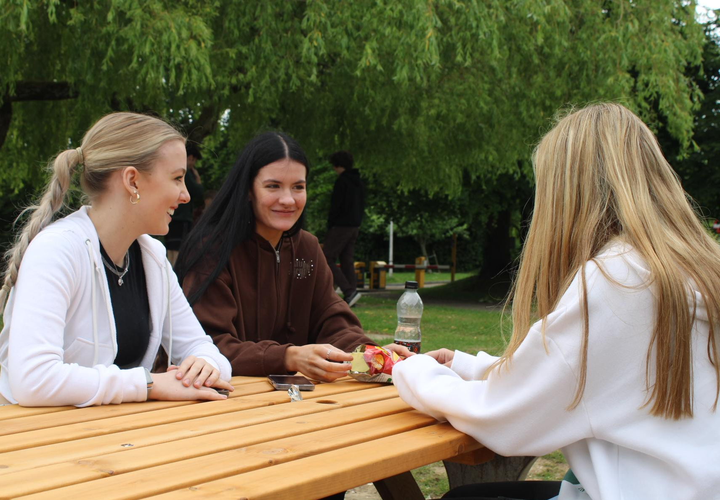
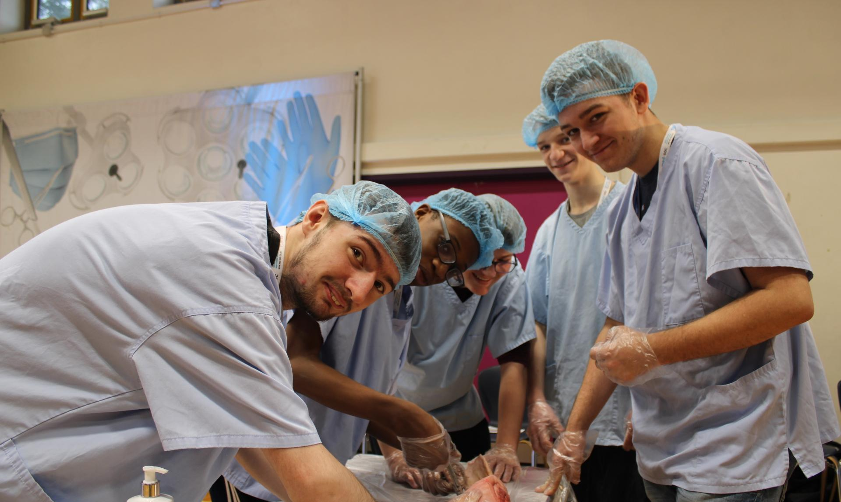
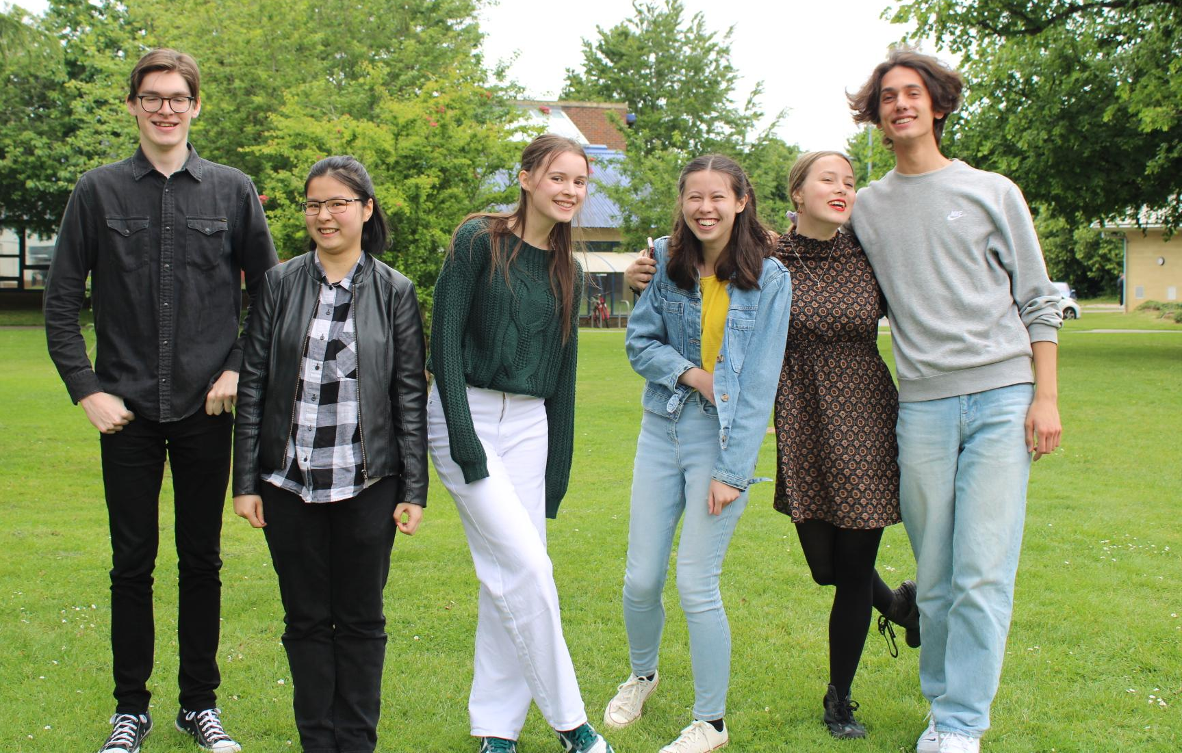
What if you could…
Enjoy subjects YOU have chosen
Shape your experience
Become the best version of yourself
Connect with other like-minded students

Slide 5
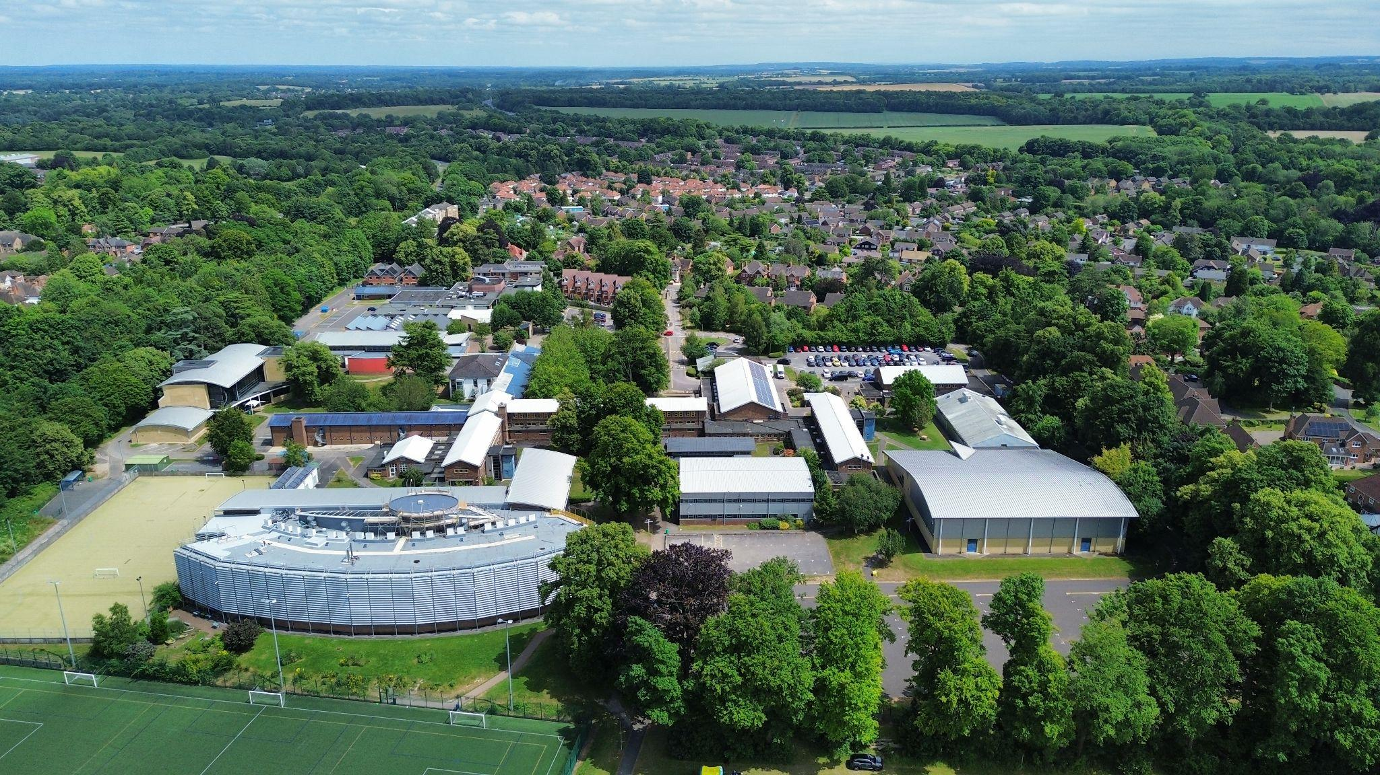
The Campus…

Slide 6
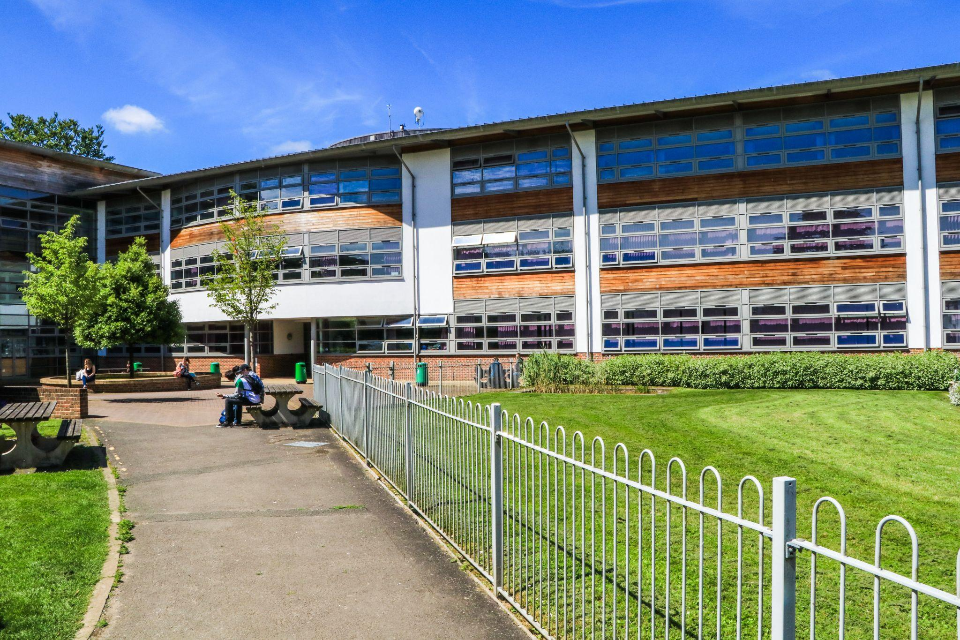
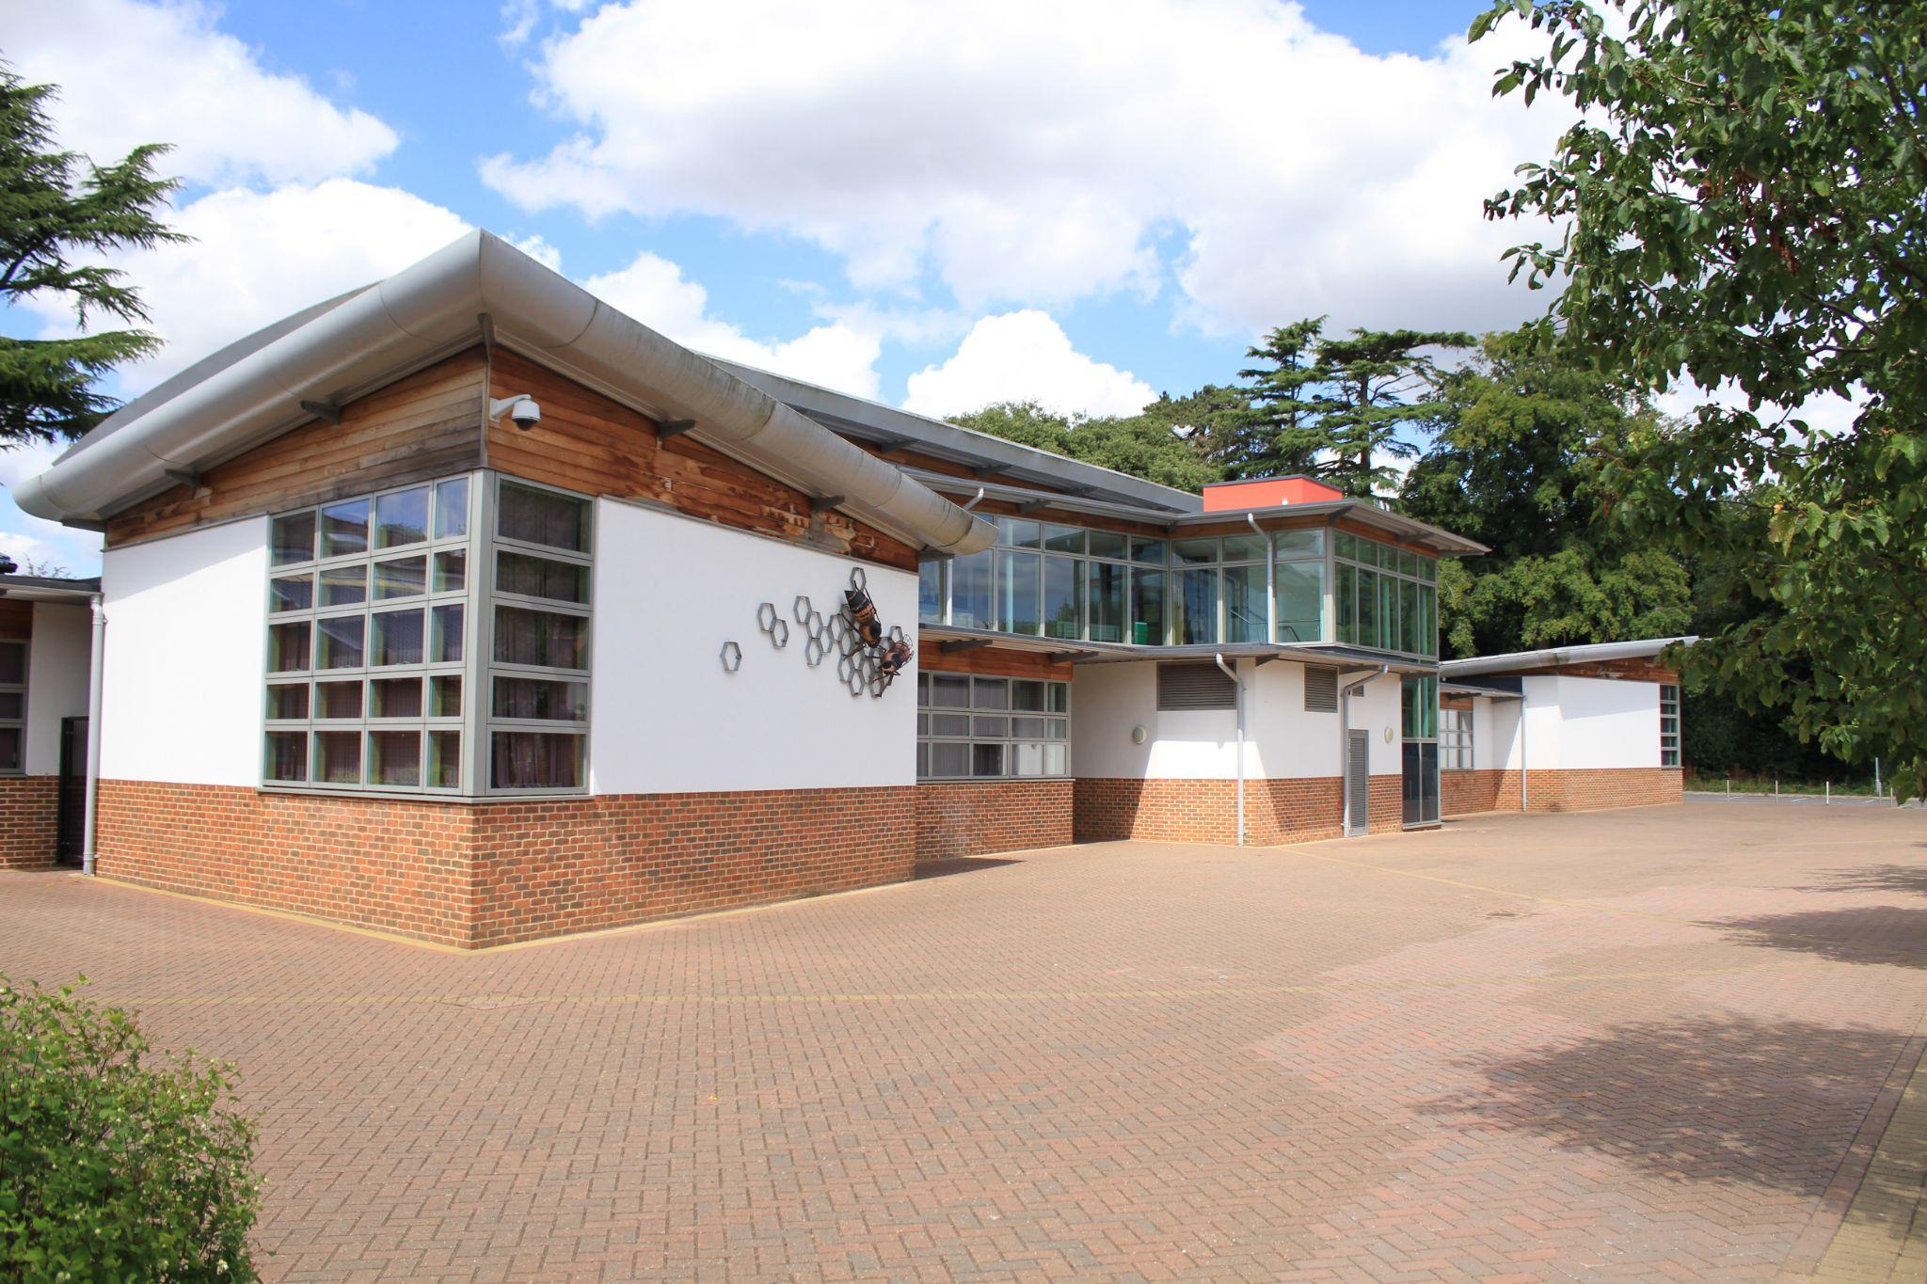
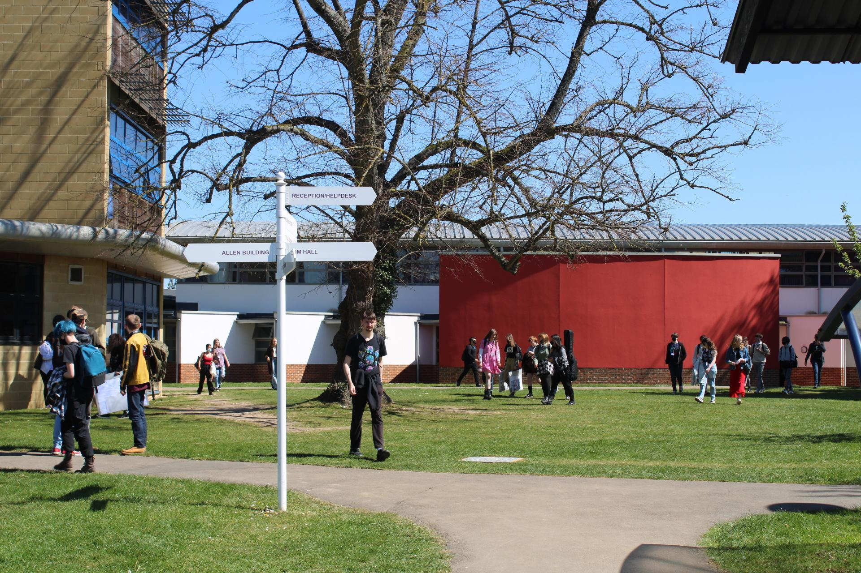
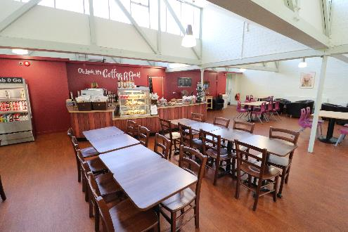
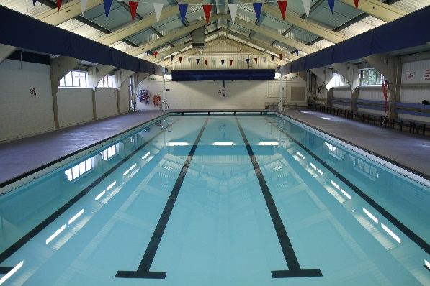
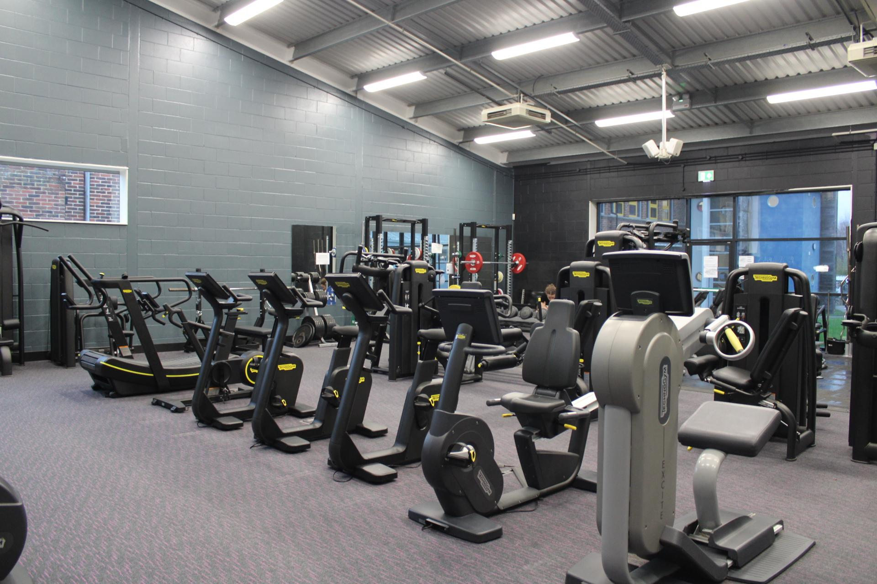
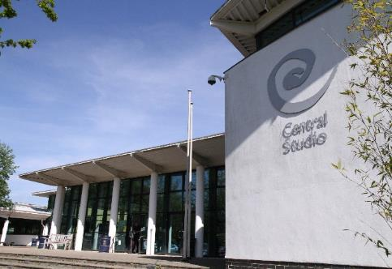
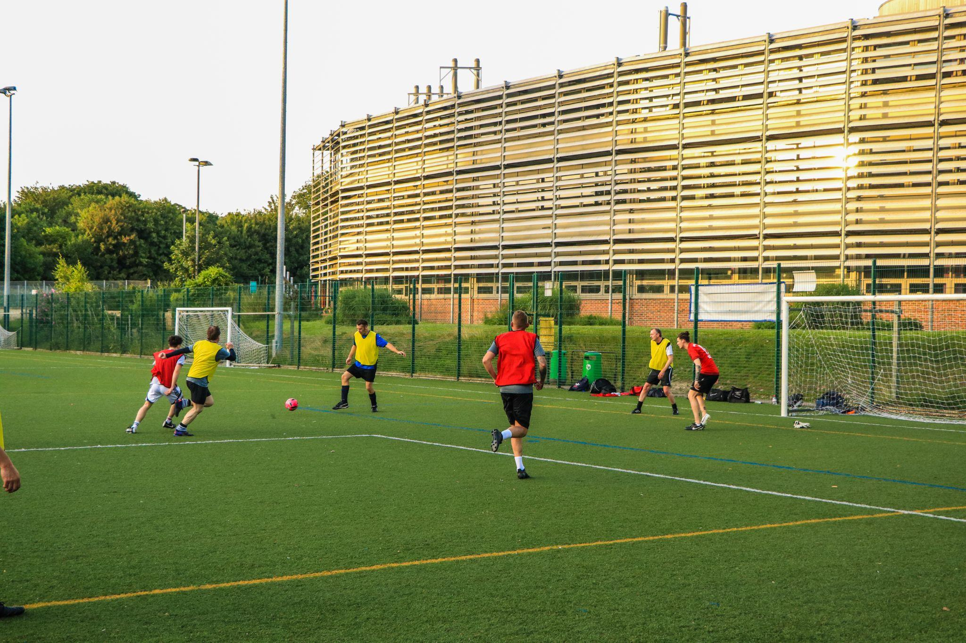
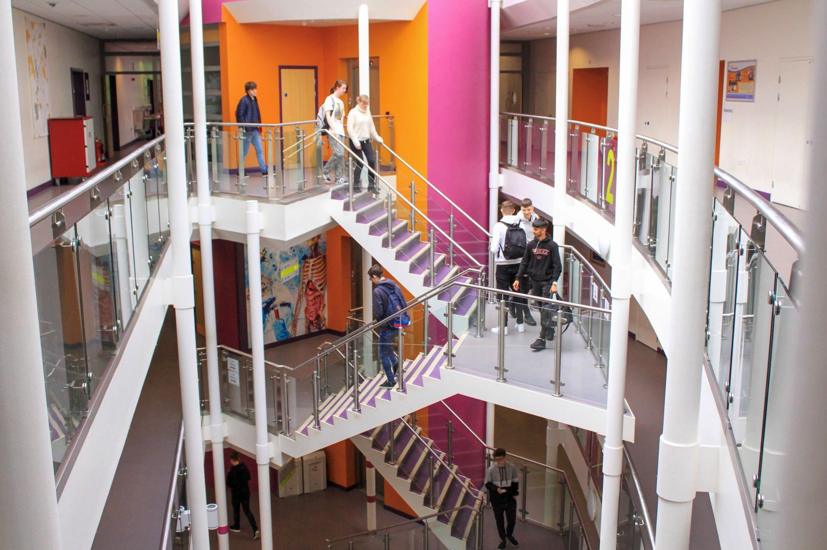
Our Facilities…

Slide 8
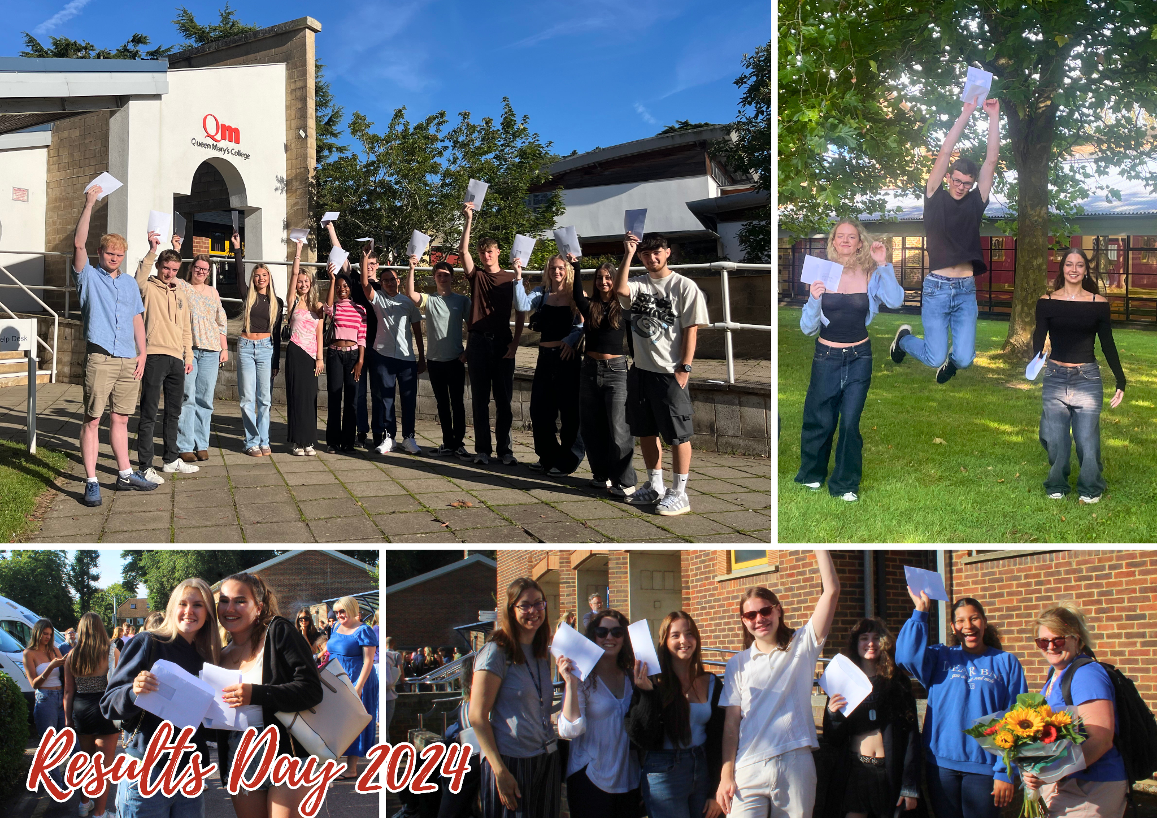

Slide 9
Queen Mary’s College is a community of, and for, people who want to learn and progress…

Slide 10
A Guide To Courses Currently On Offer…
Art and Design Art, Craft and Design
Art, Design and Communication Fine Art (Painting and Drawing) Graphic Communication Photography Fashion and Textiles
Business and Legal Studies Business Studies Economics
Criminology
Law A Level
English English Language A Level English Literature A Level
History, Philosophy and Politics
Philosophy, Religion and Ethics
Politics
History (Ancient, Tudor & Medieval and Modern)
Health and Social Care and Childcare
Health & Social Care
Early Childhood Development
IT & Computing Computer Science
Computing
Information Technology
Mathematics
Mathematics A Level
Double Mathematics (Maths & Further Maths)
Further Mathematics
Core Mathematics
Statistics
Media, Esports and Film Studies
Media Studies A Level
Creative Media Production and Technology
Film Studies A Level
Esports
Modern Languages
French, German, Italian & Spanish: A Level
Beginners’ Languages: German, Italian, Japanese and Spanish
Music
Music
Music Technology
Performing Arts
Danc
Drama and Theatre
Performing Arts
Social Science Geography Sociology Psychology
Sport and PE
Sport & PE A Level
Sport & Exercise Science
Sport & Physical Activity
Science
Biology
Chemistry
Physics
Electronics
Environmental Science
Medical Science
Perspectives on Science Extended Project Qualification (EPQ)
Level 2 Aspire Course
GCSEs
Foundation & Level 1

Slide 11
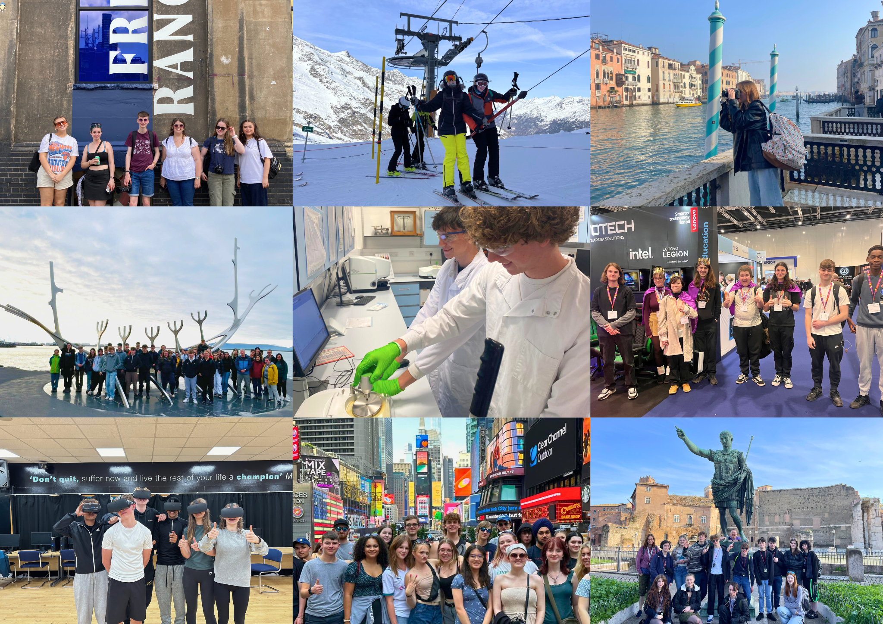
Participate in Trips and Workshops…

Slide 12
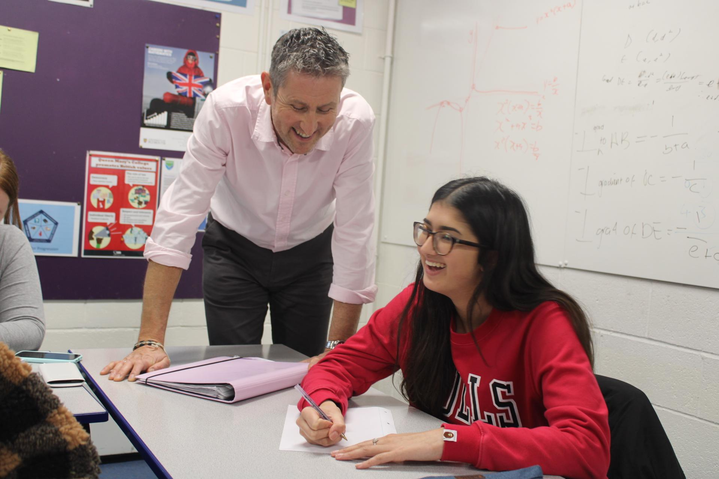
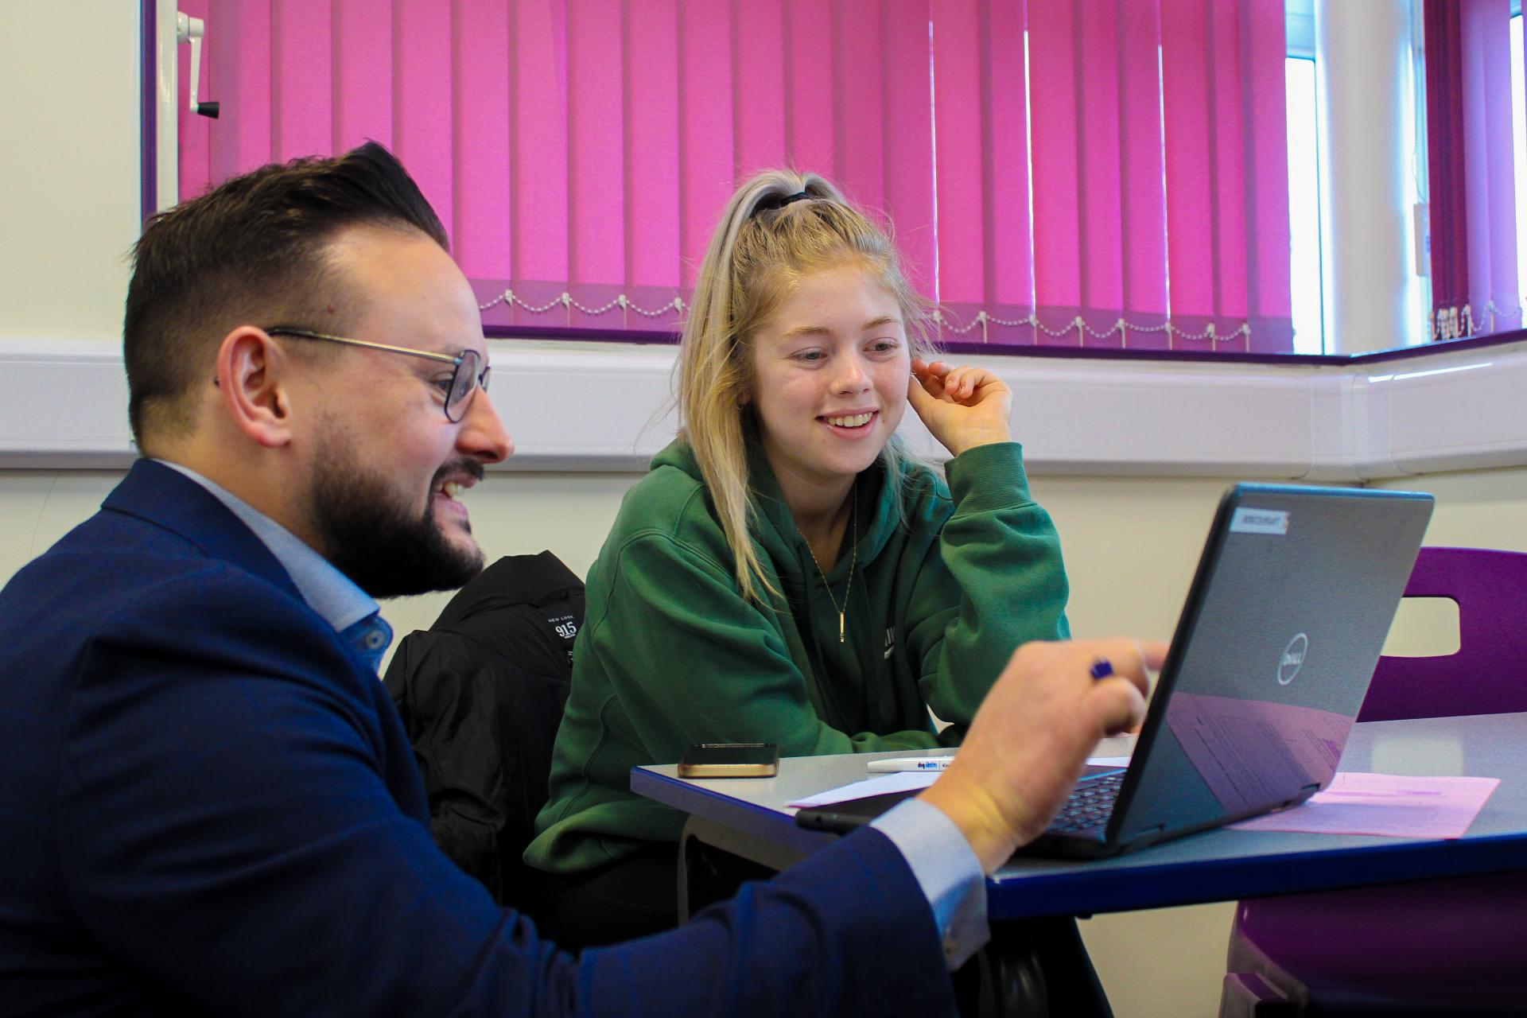
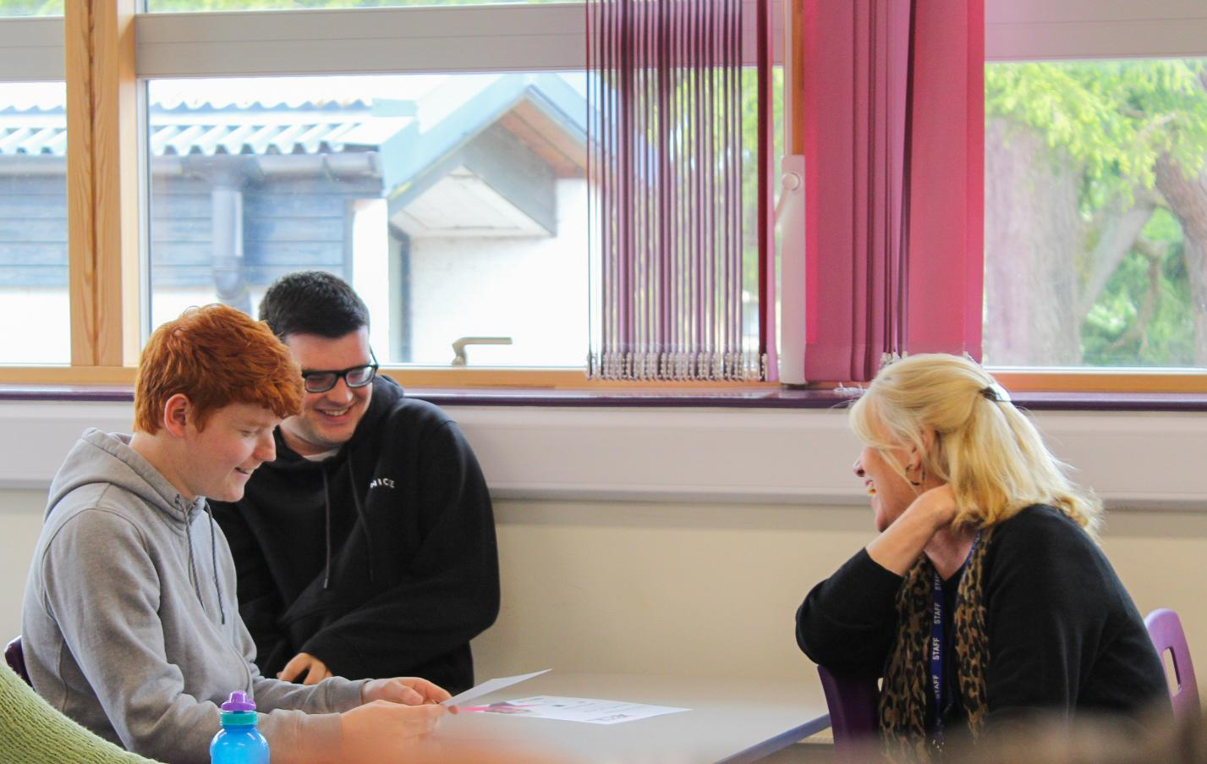
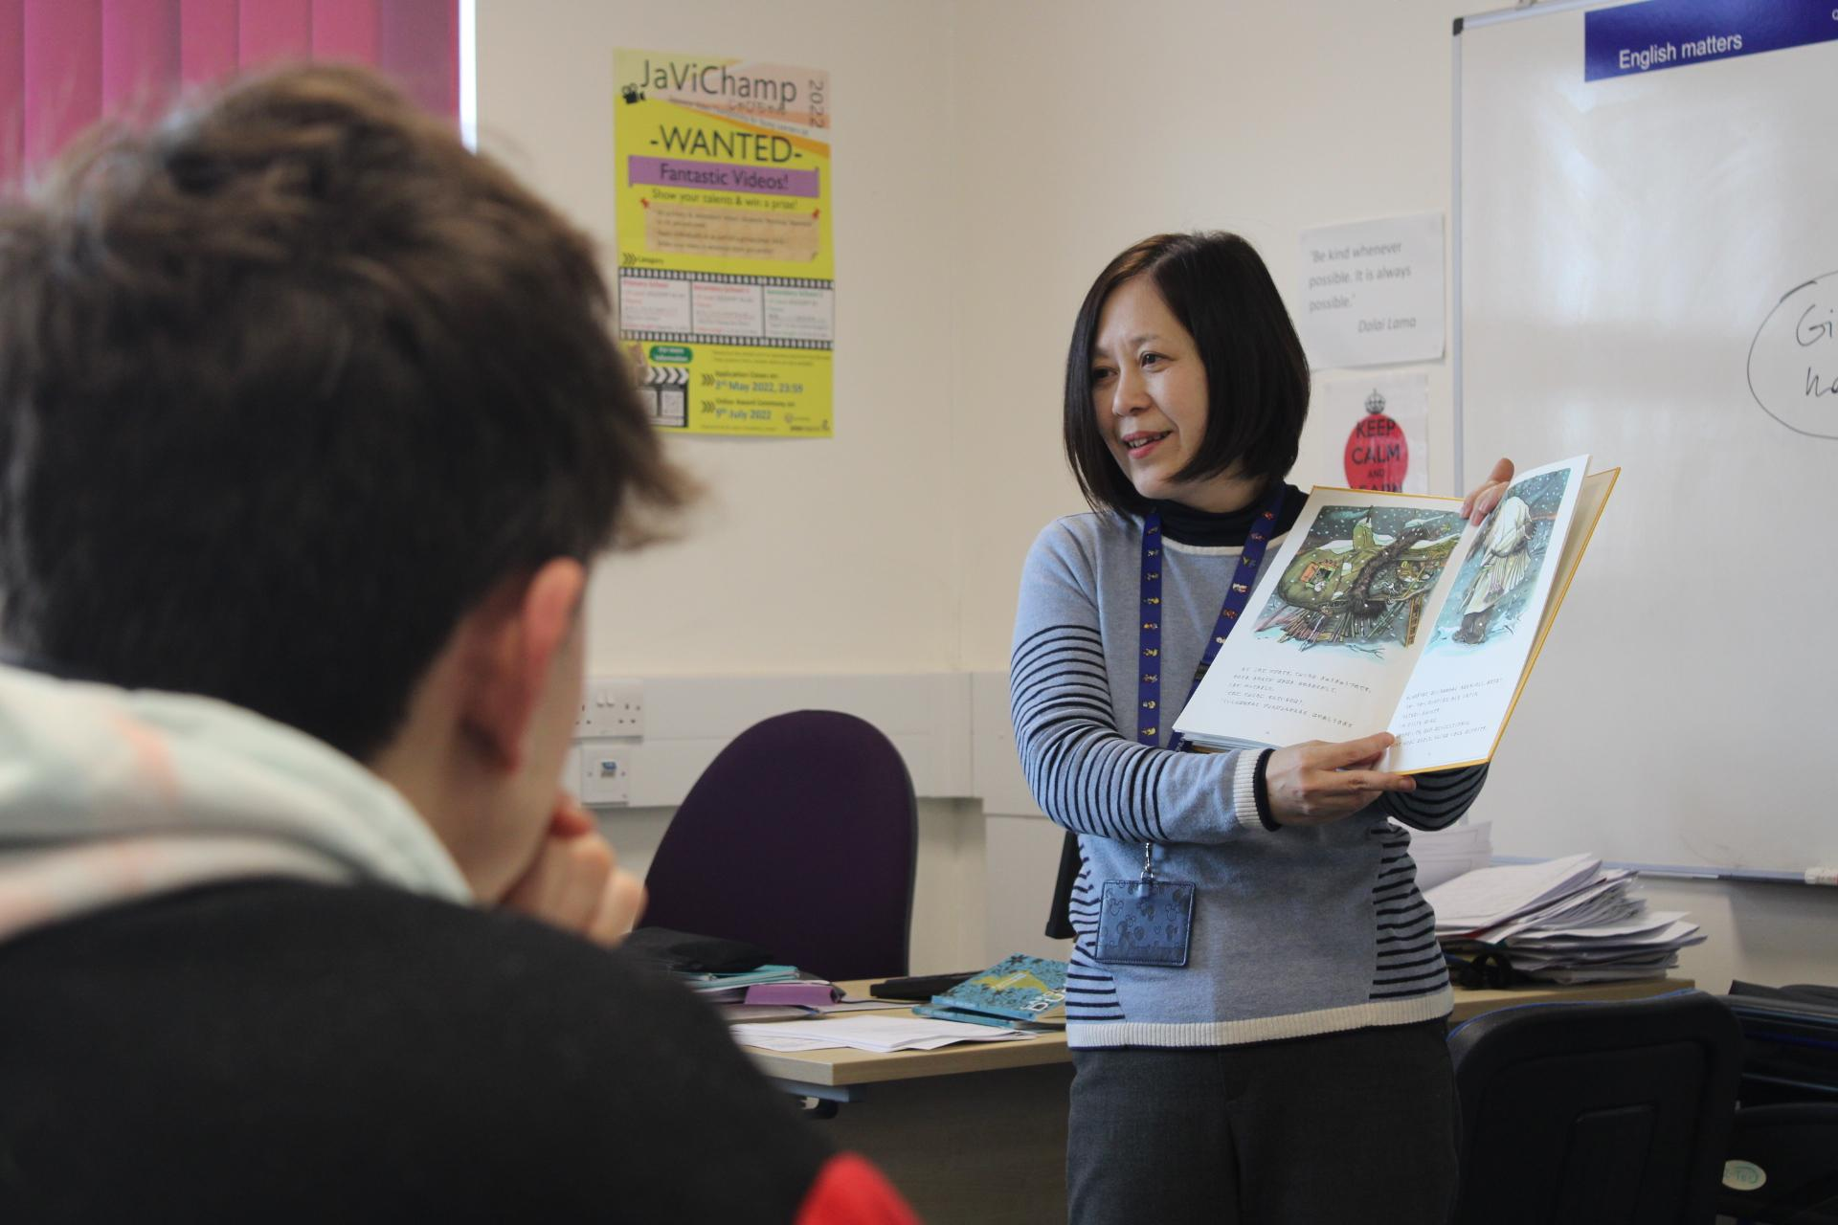
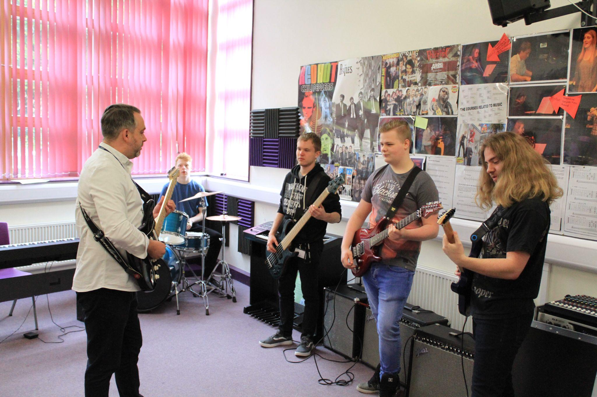
What our students have to say about their teachers…
“Rosa is an incredible tutor and teacher. I transitioned well from secondary school to college thanks to her and I'm very grateful to her for that.”
“My Teacher goes out of her way to talk to me and make sure i’m doing well whenever she sees me.”
“I always love it when Rob nerds out and starts talking about new music tech gear thats coming out in the industry!”
“I had a lot of self doubt before college but my teachers helped me improve that and I am much more confident.”
“100% best teacher I’ve ever had!”
“Nik makes all my lessons really enjoyable and also is really nice to our entire class.”

Slide 13
Find…
… our new DIGITAL PROSPECTUS

Slide 14
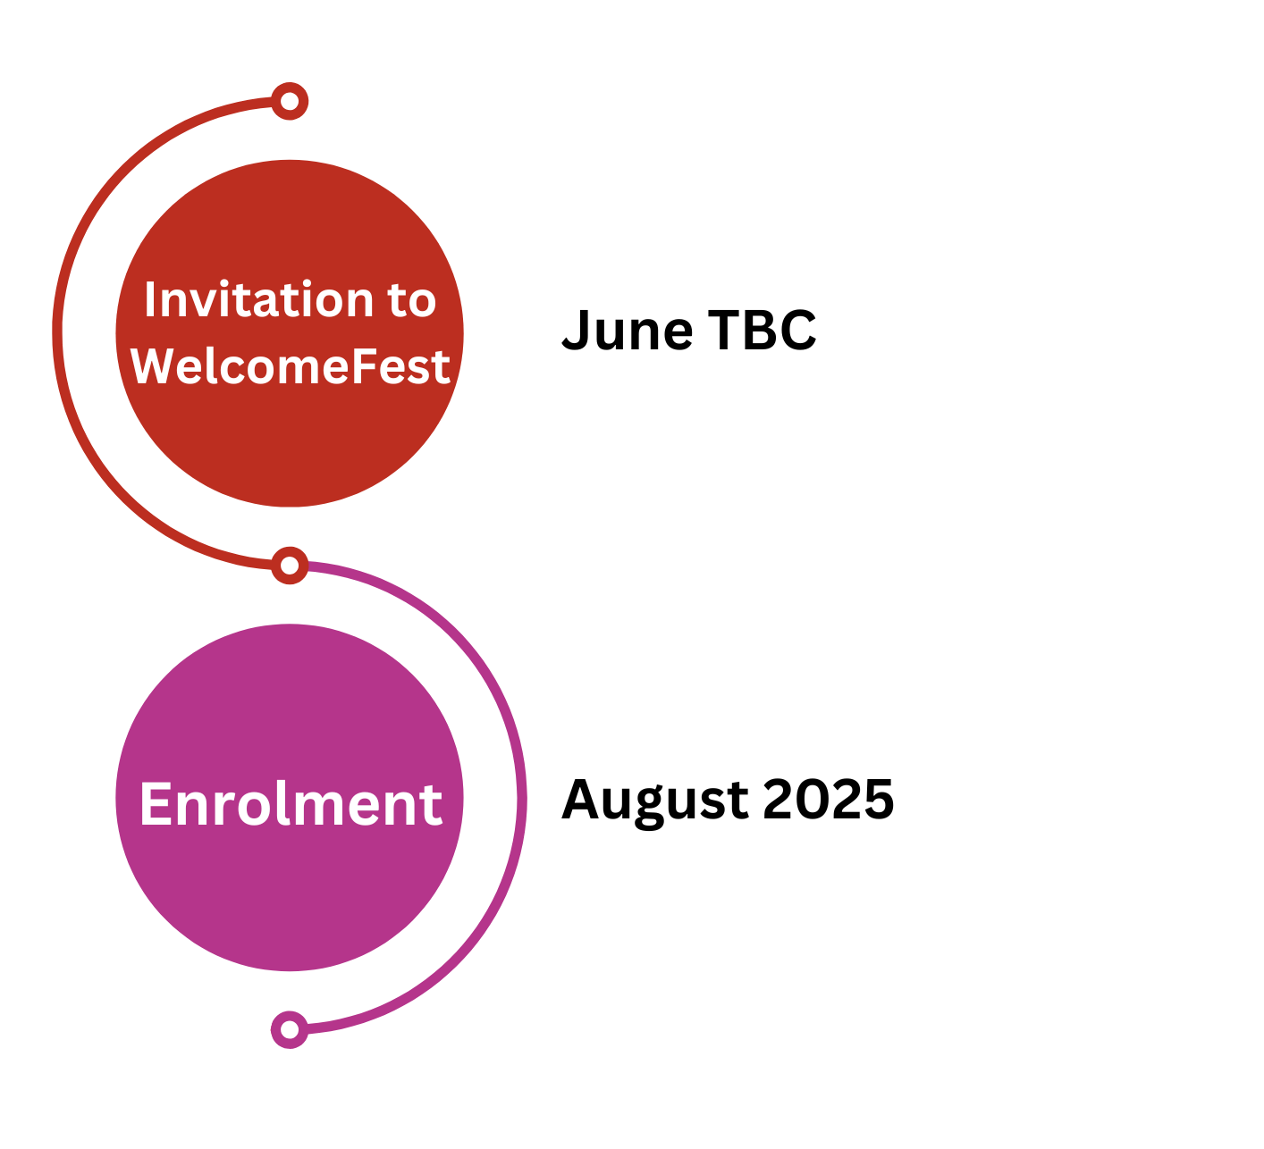
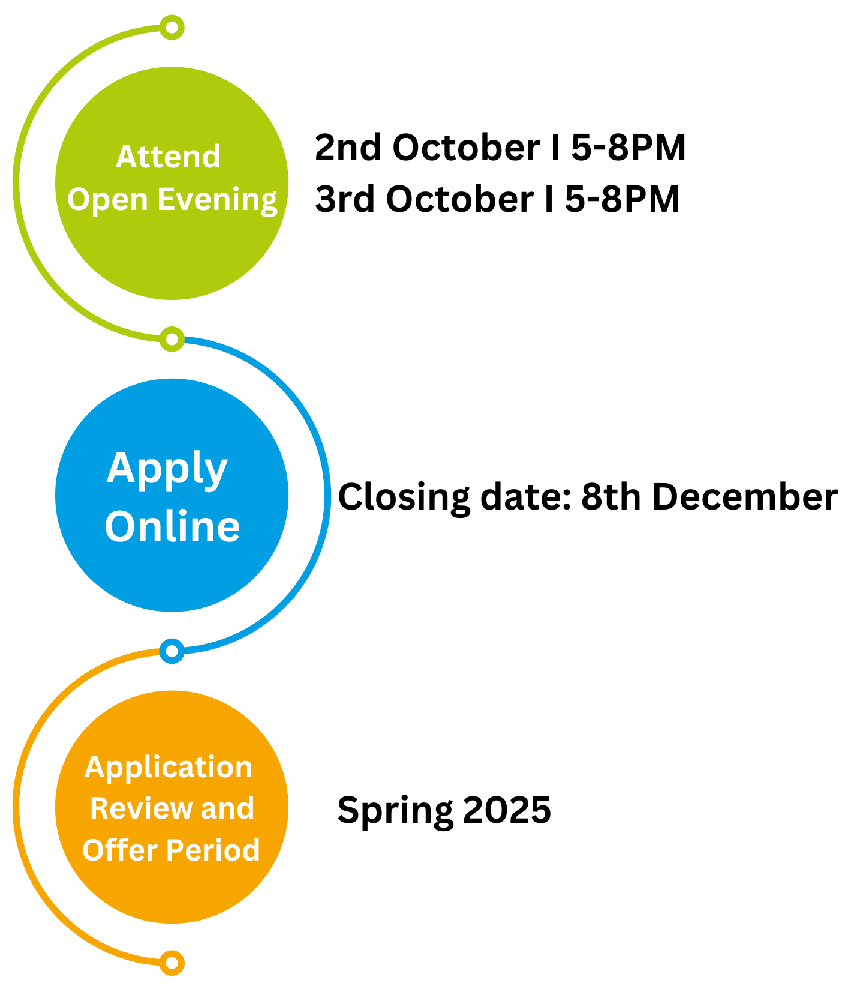
What next?
Key Dates

Slide 15
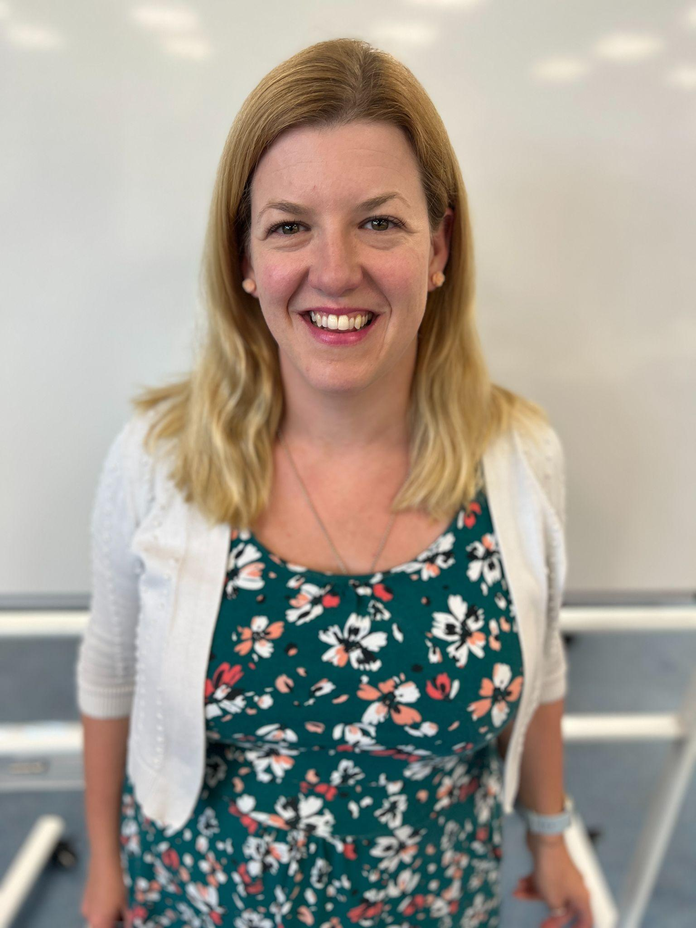
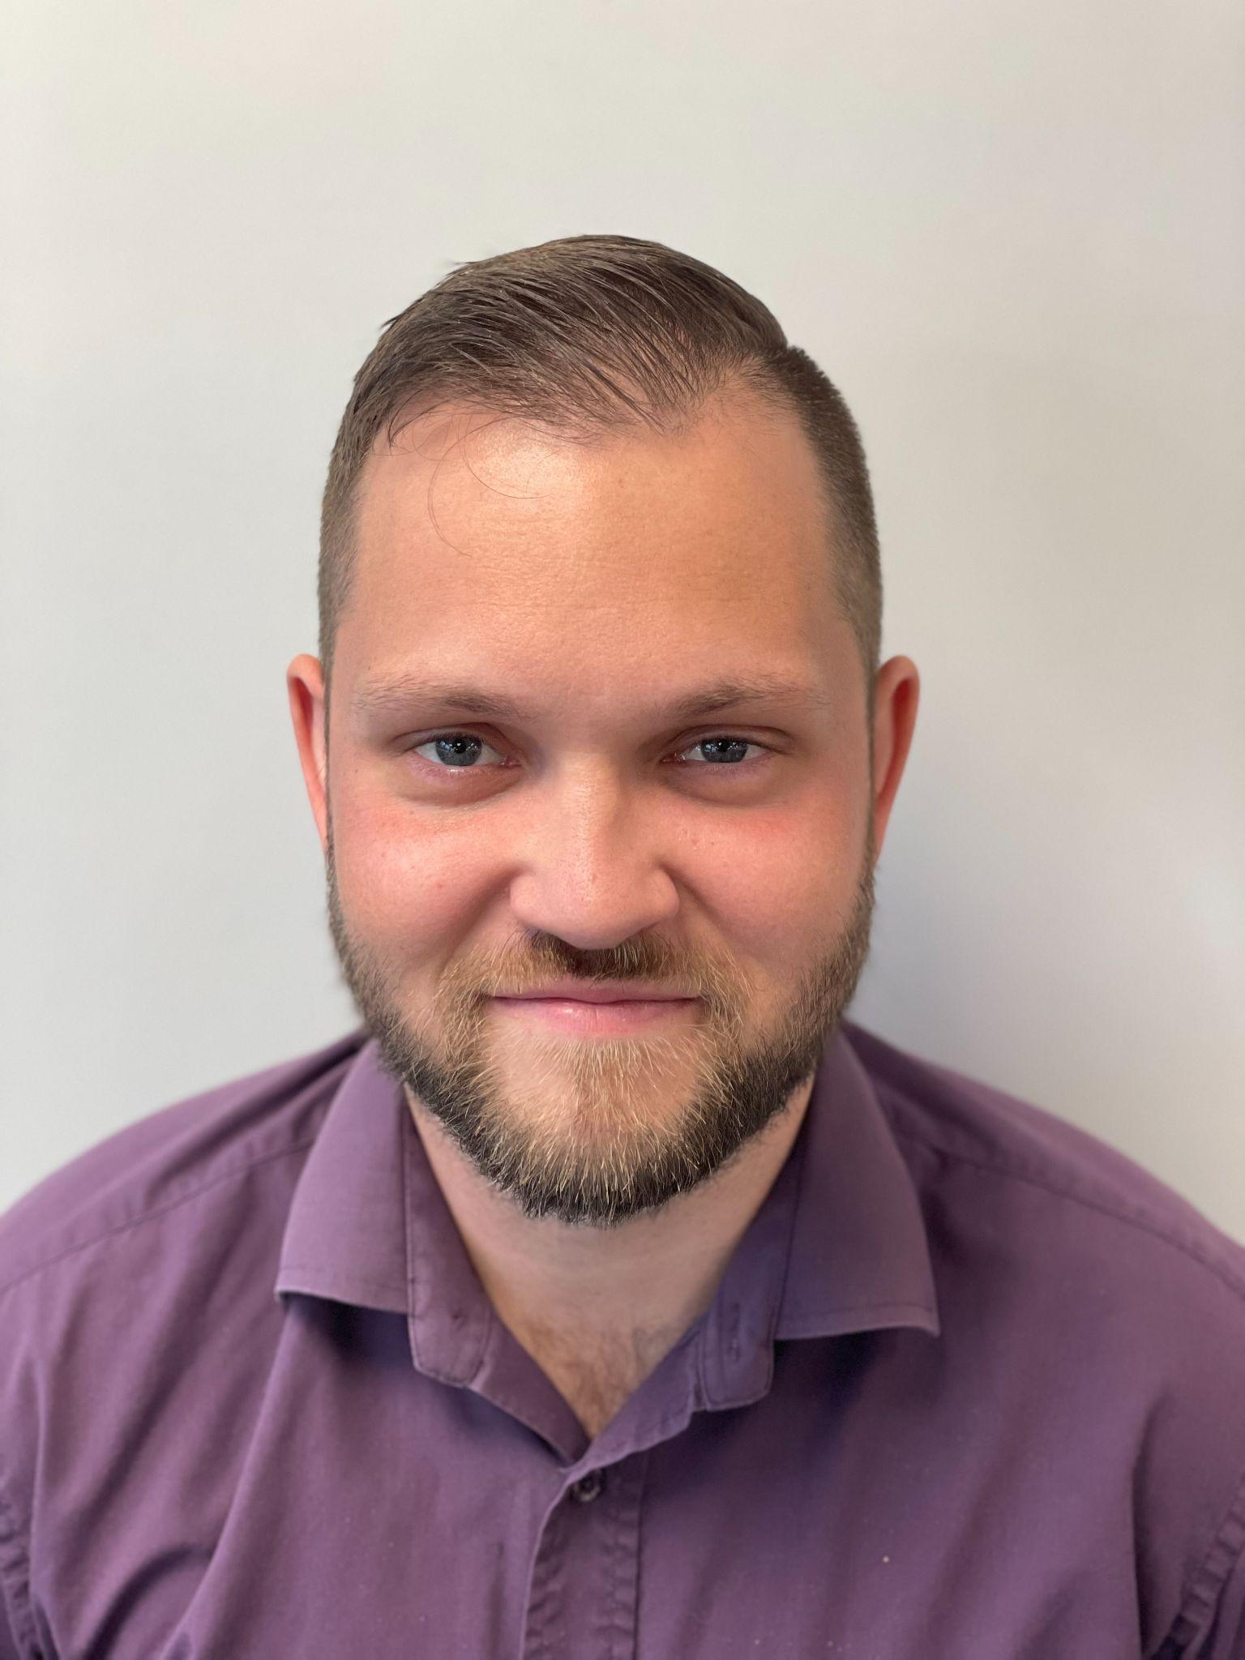
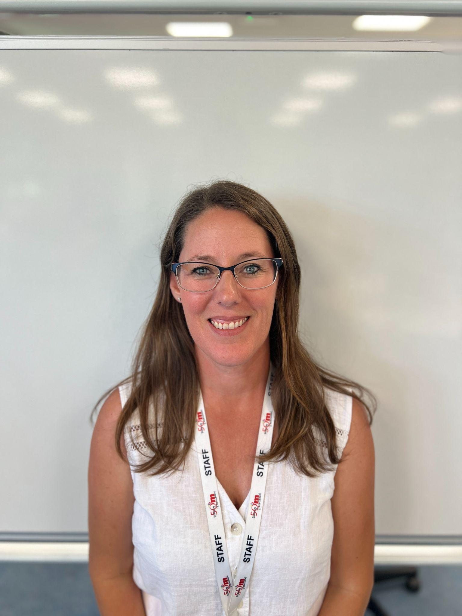
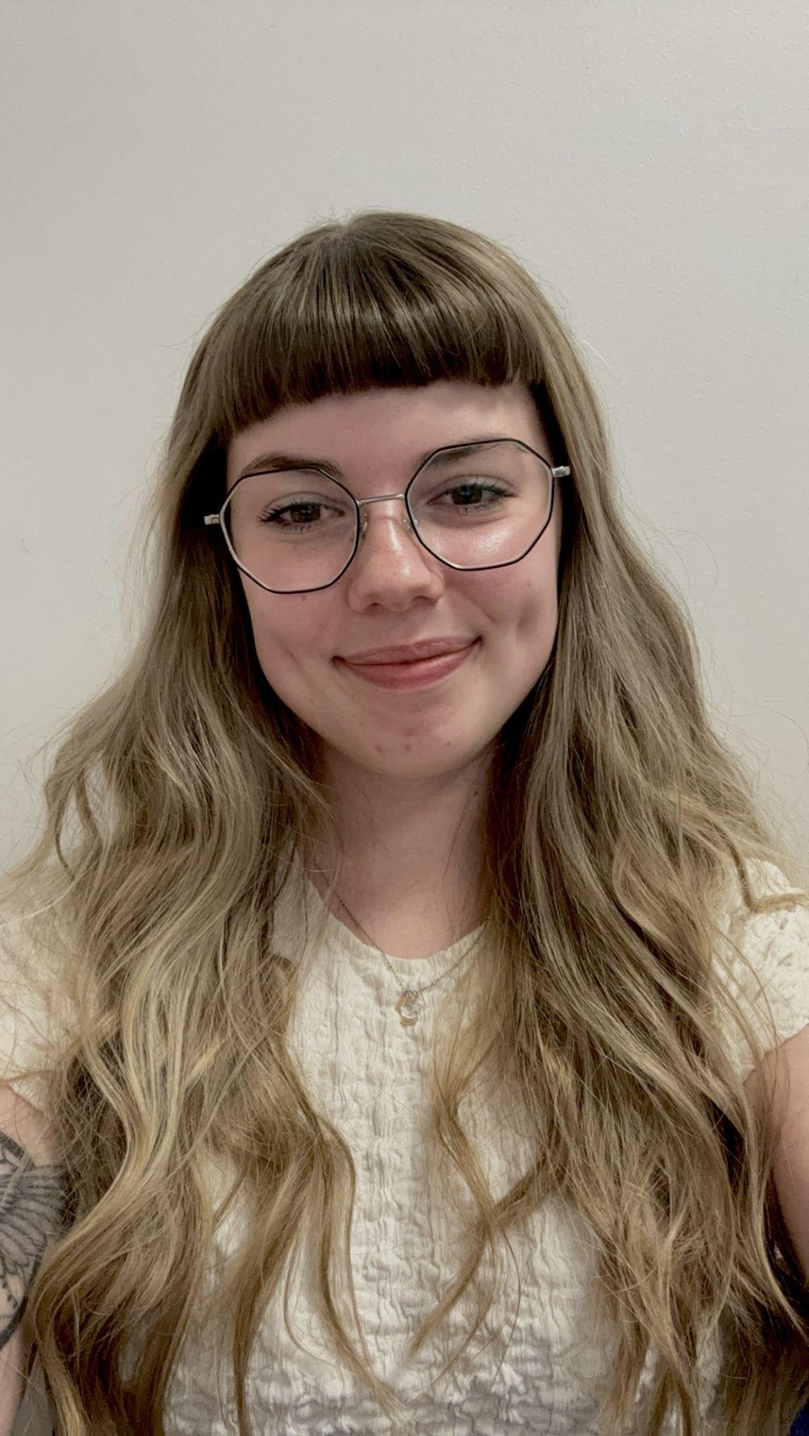
Here To Help
Victoria Renault
Director of Learning for Admissions, Careers and Progression
Sam Lay
Admissions Officer
Libby Sharpe
Careers and Admissions Administrator
Annie Wheeler
Admissions Assistant
admissions@qmc.ac.uk

