Slide 1
WELCOME TO ALTON COLLEGE
A LEVEL AND TECHNICAL EXCELLENCE
INTRODUCTION TO CAREERS
WHERE CAN YOU GO AFTER YEAR 11?

Slide 2
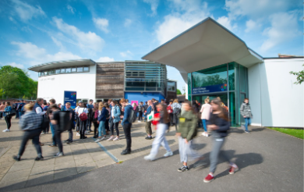
Welcome to Alton College
Extensive Curriculum Choice –
A- Levels
T-Levels
Vocational
Modern and Innovative Facilities
£xxx investment Esports / Space / business – need numbers from jane
Tell me about Alton college…
Respectful and inspiring
University standard facilities
Excellent pass rates
Independence
Supportive Learning

Slide 3
A Levels
YOUR OPTIONS
Apprenticeship
Vocational
T -Levels
You choose 3 A Level subjects
You choose 1 Vocational subject
You choose 1 Vocational subject
You choose 1 Apprenticeship
Entry requirements:
5 GCSEs at Grade 4 or above (including English Language and Maths).
Some subjects may require specific entrance requirements.
- Core Science, Maths, History, Geography, Psychology
Entry Level/Level 1 (1 year)
No formal requirements/Mainly
Grade 2 at GCSE
T Levels will combine classroom-based learning, with a compulsory industry work placement of approx.315 hours spread across the course.
Mixture of work based learning and education
Training can be taken on a day release basis
Earn while you learn
Working with a wide range of quality employers across the South Coast
Level 2 (1 year)
5 GCSEs at Grade 3 or above
Level 3/Level 3 Extended Diploma (2 years)
5 GCSEs at Grade 4 or above (including English Language and Maths)

Slide 4
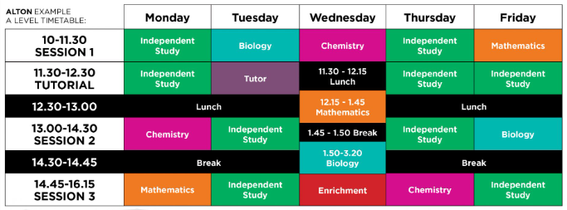
A Levels
Pass Rate 98% and almost half of our students achieving A*-B grades.
You Choose 3 A Level Subjects
38 Choices in our A Level Program
Gateway Qualification to University
You can choose New Subjects that spark an interest
Additional Extras
Extended Project Qualification
Subject extras
Work Experience
Entry Requirements:
5 GCSEs at Grade 4 or above (including English Language and Maths)
*Some subjects may require specific entry requirements that may be higher
Notes:
Evidence from academic studies which show that shorter lessons are better for your ability to concentrate – so we limit ours to 90 minutes.
Our students told us that they wanted time between their lessons to study at the campus, using our facilities which many said helped them get their homework done easier than at home, including the opportunity to complete work with their friends. They asked that we remember their need to socialise and have fun in between lessons too.
Your lessons won’t finish later than 4.15pm and many of them don’t start until 10am – so it’s easy to get to and from college, via our excellent public transport options.

Slide 5
A Level Choices at Alton College
3D Design
Economics
History
Photography
Art & Design
Engineering * BTEC
Law
Physical Education
Art Textiles
English Language
Maths
Physics
Biology
English Lit & Lang
Maths & Further Maths
Politics
Business
3D Literature
Media Studies
Psychology
Chemistry
Environmental Science
Music
Psychology *BTEC
Criminology* WJEC
Music Performance & Production * Dip L3
Public & Defence Services * L3
Business & Marketing*
Dance
French
Music Technology
Computer Science
Sociology
Digital Film & Video Production
Geography
Performing Arts
Spanish
Philosophy, Religion & Ethics
Graphic Design
Drama
*(A Level Equivalent – mixed programme)

Slide 6
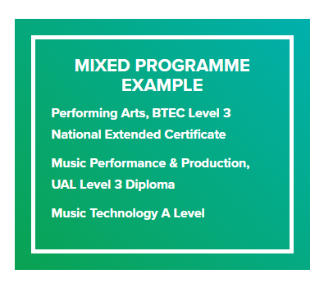
Vocational courses you can study alongside A Levels
as part of a mixed programme:
Criminology, WJEC Applied Diploma
Digital Film & Video Production, BTEC Level 3 Extended Certificate
Engineering, BTEC Level 3 Extended Certificate
Business and Marketing
Music Performance & Production, UAL Level 3 Diploma
Performing Arts, BTEC Level 3 National Extended Certificate
You can choose a mixed programme of exam and coursework-based subjects to suit your learning style.

Slide 7
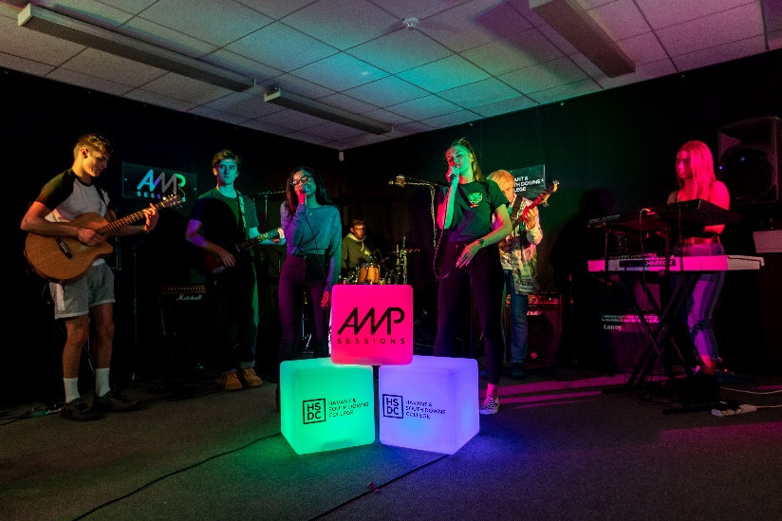
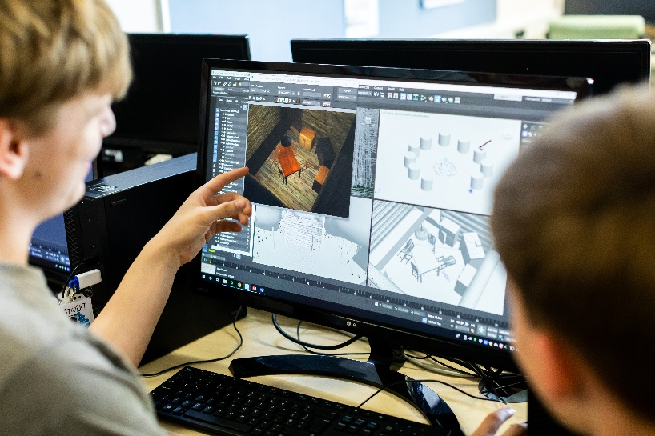
Vocational Courses
You focus on ONE Subject Area
Mainly assessed through practical assignments, written coursework, research projects; some subjects may include written exams
Entry Requirements:
Entry Level / Level 1 (1 year) GCSEs below grade 3
Level 2 Diploma / Pre-T level (1 year)
4 GCSEs at Grade 3 and above
Level 3 / Level 3 Extended Diploma (2 years) 5 GCSEs at Grade 4 and above (Including English Language and Maths)

Slide 8
Vocational Course Options
Art & Design*
Digital Film & Video Production
Business*
Engineering*
Creative Media*
Esports
Film & TV Production
Music Performance & Production *
Early Years & Child Care*
Games Design & Development
Public Services*
Health & Science*
Sport*
Digital IT*
* Also available as Level 2

Slide 9
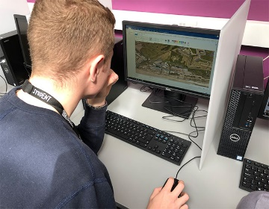
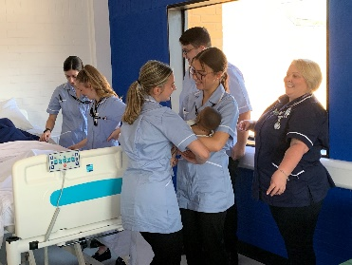
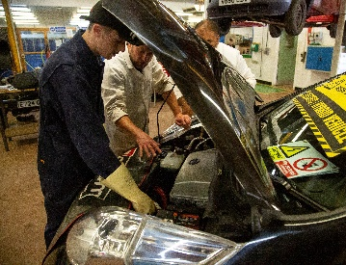
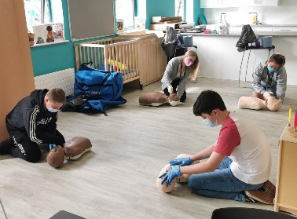
COURSE CHOICES – T-LEVEL
Level 3 Technical Qualification
For students who want to develop work-related knowledge and skills
T-Levels will combine classroom-based learning, with a compulsory industry work placement of 315 hours spread across the 2 years
T Level Study route will be a reat pathway to Degree Apprenticeships
Design, Surveying & Planning for Construction
Business and Management
Digital IT – Production, Design & Development
Engineering & Manufacturing – Design & Development
Entry Requirements -
5 GCSEs at Grade 4 and above, including English Language and Mathematics
Health and Nursing
Media Content Creation & Production
Vehicle Maintenance and Repair
Education and Childcare

Slide 10
NEW FOR 2024 stem students
SPACE TECHNOLOGIES PROGRAMME
Industry-standard facilities
New equipment
Unique opportunities with…
Surrey Space Centre at the University of Surrey
Portsmouth Research Institute for Space Missions (PRISM) at the University of Portsmouth
Space at Southampton initiative at the University of Southampton
Key employers in the space and satellite industry through the Space South Central cluster.
How does it work?
Ideally you
would study :-
Maths A Level,
Physics A Level,
Extended Certificate in
Engineering
“Alton College launches into the future with £500K investment for new space technologies programme”

Slide 11
THINK ABOUT
HOW ARE YOU GOING TO GET TO AND FROM COLLEGE AT DIFFERENT TIMES?
WHAT GCSE RESULTS ARE YOU AIMING FOR?
DO YOU HAVE A CAREER IN MIND?
ARE YOU READY FOR THE WORKPLACE?
ARE THERE ANY SUBJECTS YOU ENJOY AT SCHOOL?
HOW DO YOU LIKE TO LEARN?
WHAT SUBJECTS DON’T YOU LIKE?

Slide 12
BE EXTRAORDINARY
AT ALTON COLLEGE
BE ASPIRATIONAL
BE EMPLOYABLE
BE ADVENTUROUS
BE INVOLVED
BE ACTIVE

Slide 13
1
2
3
4
5
6
Attend an Open event
Submit an Application
Attend your Interview and Insight Events
Attend the New Student Festival
Enrolment
Welcome to HSDC!

