Slide 1
Work Experience
Perins School in partnership with EBP South

Slide 2
Why do it?
Notes:
So many different reasons!
Work experience is proven to help students with their employability skills, but it can also help someone gain confidence in themselves! Some of the main benefits of work experience are;
Skills Development, Gaining a better understanding of the world of work, Putting current skills and knowledge into practice, Discover what skills employers look for when hiring for future Job Vacancies, Develop self confidence and communication skills, Improves motivation and academic attainment and Improves young people’s employability skills.
This can help with getting into College or getting apprenticeship
Reports have showed that young people who took part in four or more activities with employers while at school earn an average of £23,100 a year between the ages of 19 and 24. Those who report having had no employer contact at school earn an average of £19,500 – £3,600 less. Each employer contact was found to be worth on average an extra £900 a year.
CLICK

Slide 3
Partnership with EBP South
Working alongside EBP to secure placements
EBP complete all the checks and paperwork
Paperwork is sent home and parents/carers to complete all paperwork
We pay EBP a fee per student per secured placement.

Slide 4
Two Different Pathways
Deadline- 30th September 2024
A form will be emailed out and you must choose one pathway.
Notes:
There are two options for securing a placement. Online sing the EBP South system or finding an own placement.
You must make a decision about which you wish to do before 30th September. Then complete the form which will be emailed out, indicating your option.
If you choose the online version, EBP South will create a log in and this will be given to the student in tutor time.
If you choose the own placement, an electronic copy of the own placement form will be on the school website or a paper copy can be collected from the student's tutor or Miss Craig

Slide 5
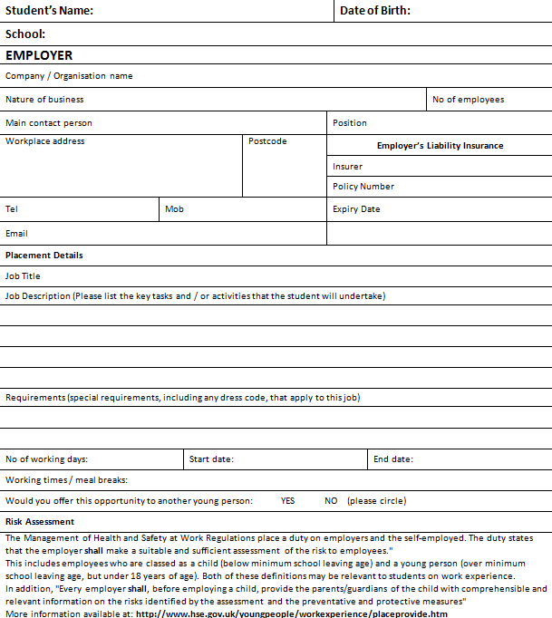
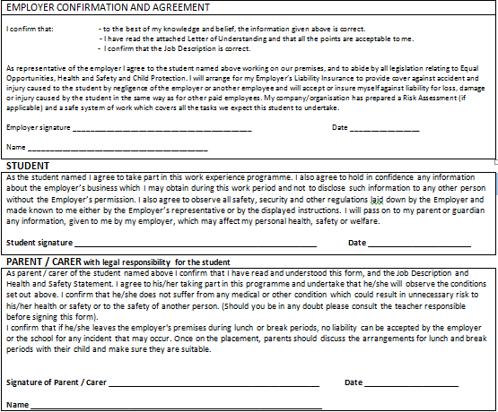
Own Placement
Notes:
Take the form to the employer
Enter in Student Details
The employer need to fill in Employer details – address, contact information, dress code, hours of work, lunch break etc
Employers Liability Insurance details are needed as well
Hand the form to Miss Craig or tutor
It will be processed
A consent form will be sent out to confirm its been processed ok
Hand consent form to Miss Craig

Slide 6
The Online Process
Learners Search and Apply
Some employers ask for applications
Employer Decides
Placement Confirmed
Return the consent form to the school. Once this is done the process is complete!
Schedule an Interview
A consent form will be printed and delivered to the student's tutor
Notes:
1 - Search and apply for up to 4 placements and put them in a order of preference.
2 – Application generated by EBP South and they will co-ordinate with employer to secure placement
3 – Employer makes decision if yes great, if no progress to other applications
4 – Once placement is confirmed a consent form will come out via the student's tutor. Sign this and return to Miss Craig
5 – Arrange to have an interview – It is very important that you contact your employer to arrange an interview. Last year several students had their placements cancelled by the employer as they had not contacted them before the placement was due to start.

Slide 7
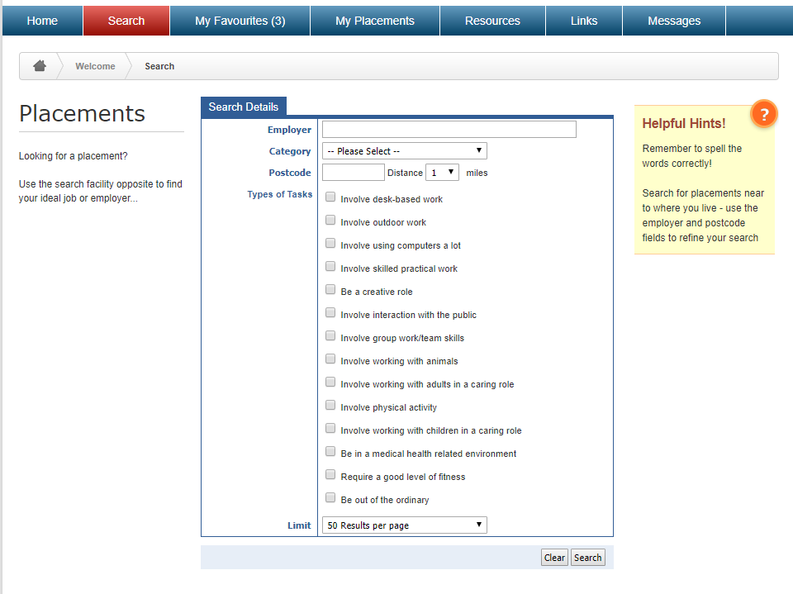
The Online System
Notes:
Searching for available placements
First task will be to enter your postcode and how many miles you wish to travel
There are multiply ways to search using various criteria
You can search under ‘job title’ using key words such as admin or engineer or the employer name can be entered if you are looking for someone in particular or choose a category there are 23 ranging from admin to transport or types of tasks, 14 to choose from they include outdoor work, physical activity or team skills to name a few
So there are many ways to search a hint would be to only use one criteria at a time and the two which will bring the greater results are either category or types of task.
When you have selected your criteria just click on search.

Slide 8
The Online System
Notes:
Results are displayed like this you can click on distance to order them in distance from your postcode in case you don’t want to go further from the end of your street but please don’t use that as your main driver for choosing a placement.
A click on the postcode will open google maps to indicate where the placement is you will then be able to work out if you can realistic get to the placement, how long will it take.
Hover the mouse over the job title or click on it to reveal the job description

Slide 9
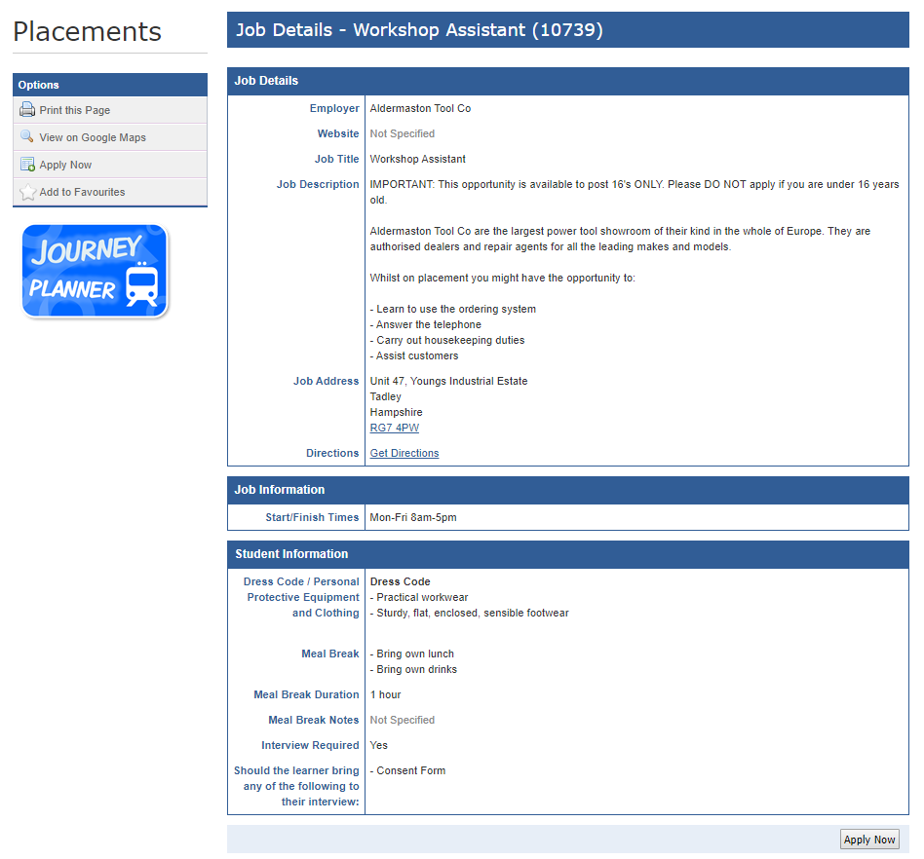
The Online System
Notes:
The job description shows everything you need to know about the placement.
Question to the students here what is the maximum amount of hours you can work in a day ‘8hrs’ this means a total of 40hrs a week. You can start at 7am, finish at 7pm, work on a Saturday. You might have to provide your own safety boots, not be allowed to wear nail varnish, have to wear a uniform. Take all this into consideration before applying.
Once you have read all the information and wish to apply then simply click on apply now will open a new screen where need to click on apply now again. Once done you have applied it’s automatically added to your placements. You then need to repeat the process up to a maximum of 10 placements.
It is important that you are sure about your choices because once we have confirmed a placement with an employer, a fee of £39 could be made for cancellation.
Print
View
Apply
Add to Favourites

Slide 10
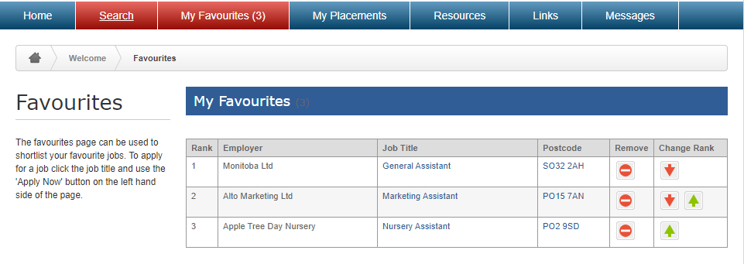
The Online System
Notes:
Favourites

Slide 11
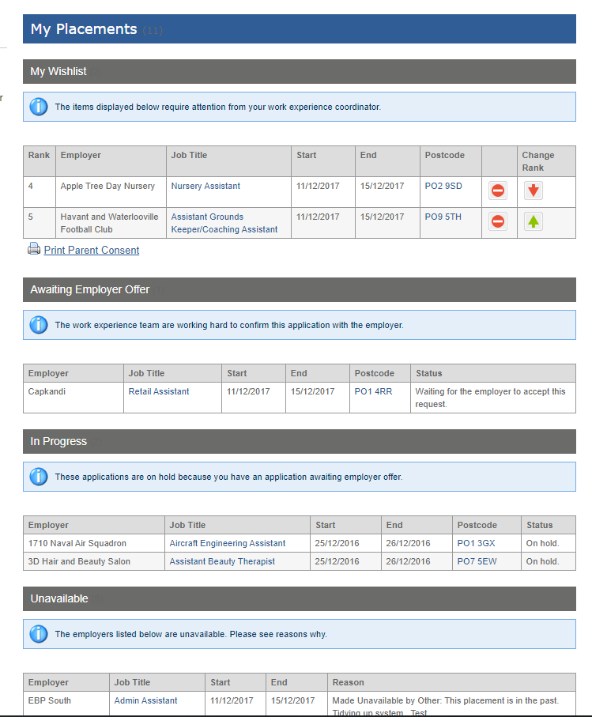
The Online System
Notes:
When you have finished making choices they can be ‘ranked’ in order of preference
We may also message you especially if the employer has requested more information so please check the website on a regular basis once a week as a minimum.
You will then see the progress of your application, any messages, notifications.
The website is accessed by around 5000 students. This may mean you don’t get your 1st choice or sometimes none of your original choices.
Reason behind this is that while a placement is visible multiple students can request the same placement, this happens with popular employers, local primary schools.
Once a school allocates a placement to a student then the placement is no longer visible and applications with other students can’t be progressed this prevents an employer receiving more applications than opportunities available.
This means you need to be proactive and monitor your placements
When this happens we move onto the other placements in your list.
Important things to remember
Certain jobs are more popular and are often over subscribed such as (healthcare, solicitors, architects, construction and mechanics) the earlier you apply the better but this still doesn’t guarantee your place. The only guaranteed placement is an own placement.
Work Experience is EXPERIENCE OF WORK, it does not have to be linked to your future career choices. Whether you plan on college, an apprenticeship or university, at some point in your future you may want or need to get a part time job. The transferrable skills you learn during work experience will give you confidence and equip you with a wide range of skills which can be used in many different professions.
Please read the job descriptions carefully. Some of them will require you to complete a written application before they will accept you on a placement.

Slide 12
Last Messages
Please make sure you have completed the pathways form by 30th September
Charge to parents
Continue to check online system
Sometimes the employers takes a while to get back to EBP- they do chase!
We MUST have the final consent form in to confirm the placement.

Slide 13
Work Experience Dates
Monday 31st March – Friday 4th April
(Inclusive)

Slide 14
Thank you for Listening!

