Slide 1
Year 11 CORE Information Evening
19th September 2024
Mr Barber – Head of English
Mr Holligan – Head of Maths
Mr Adams – Head of Science
Miss Sweetman – Head of Year
Mr Dixon – Progress Lead

Slide 2
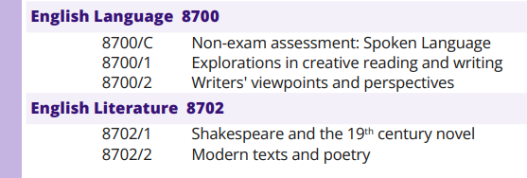
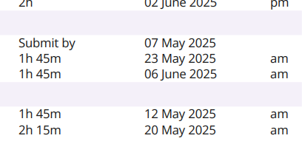
ENGLISH
LITERATURE
LANGUAGE

Slide 3
English qualifications and assessment objectives
There are two qualifications available in English- English Language and English Literature.
We follow the AQA exam board.

Slide 4
English qualifications and assessment objectives
There are two qualifications available in English- English Language and English Literature.
We follow the AQA exam board.

Slide 5
English qualifications and assessment objectives
There are two qualifications available in English- English Language and English Literature.

Slide 6
English qualifications and assessment objectives
There are two qualifications available in English- English Language and English Literature.
We follow the AQA exam board.

Slide 7
English qualifications and assessment objectives
There are two qualifications available in English- English Language and English Literature.
We follow the AQA exam board.

Slide 8
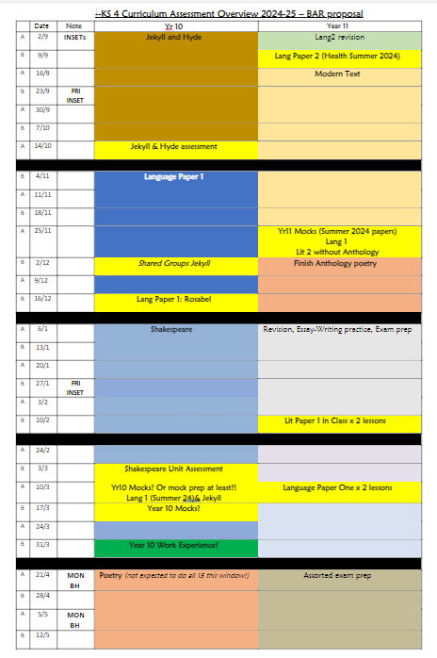
WHAT ARE WE DOING?
Alternating study between Language and Literature;
2x Language practice papers in year 10 PLUS mocks;
1x Language practice paper in year 11 PLUS mocks, plus IL;
End of unit assessments for Creative Writing and Literary Study units;
1x open revision session per week.

Slide 9
WHAT CAN STUDENTS DO?
Cgpbooks.co.uk
Flash cards
Mind maps
Posters/Post-its
Organisers

Slide 10
WHAT CAN YOU DO?
school@perins.hants.sch.uk
Ask questions
Shared reading

Slide 11
Perins Maths Core Information Evening 2024 Mr Holligan

Slide 12
Mathematics Dates and Papers
Paper | Date | Duration | Type | Marks
1 | Thu 15th May (am) | 90 min | Non-calculator | 80
2 | Wed 4th June (am) | 90 min | Calculator | 80
3 | Wed 11th June (am) | 90 min | Calculator | 80
Pearson Edexcel Exam Board
Each paper carries an equal weight

Slide 13
Tiers of entry
Foundation​ | Grade​ | Higher​
​ | 9​
​ | 8​
​ | 7​
​ | 6​
 | 5​
Pass | 4​ | Pass
 | 3​
 | 2​ | ​
 | 1​ | ​
​ | U​ | ​
In most cases you child will already know if they will do the foundation or higher papers
This is finalized in February after the mocks

Slide 14
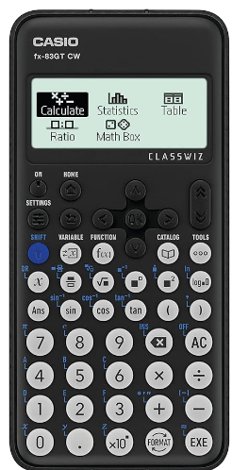
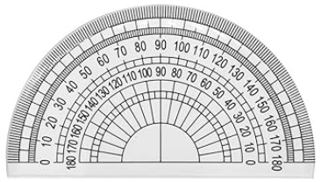
What students need to bring
They need a MODERN scientific calculator
Students who have and use their own calculator do better in exams

Slide 15
Revising for mathematics
Skills practice
Sparx
Homework
Independent learning
Sparx Maths
Corbettmaths
How to videos
Practice questions/ans
Videos and Worksheets – Corbettmaths
MathsMadeEasy
Revision by topic/grade
Sample questions
Edexcel GCSE Maths Revision | Past Papers | Tests | Worksheets (mmerevise.co.uk)
Past paper questions
Provided by school
Materials on sharepoint
Maths - Home (sharepoint.com)
Maths genie
Has past papers with sample answers written in a student friendly way
https://www.mathsgenie.co.uk/papers.php

Slide 16
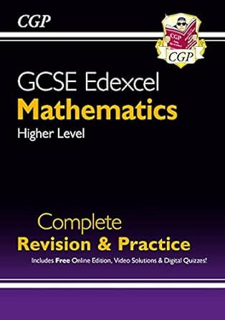
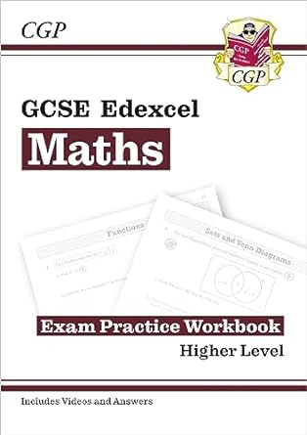
How you can support
Help your child start revising early
Maths is a skills-based subject: well-practiced skills are retained. Last minute revision doesn’t really help
If possible, provide a quiet space for revision
GCSE maths is based on an ability to independently solve problems
If possible, print out past papers
It’s helpful to practice writing answers (most students who use a laptop for other subjects will still do their GCSE maths on paper)
Make sure they have a calculator
Students who have and use their own calculator do better in exams
Provide a revision guide
Available on the school shop (Scopay)
Revision material can also be found in stationary stores and online. Make sure it states:
Edexcel GCSE Maths
Grade 9 - 1
Foundation or Higher

Slide 17
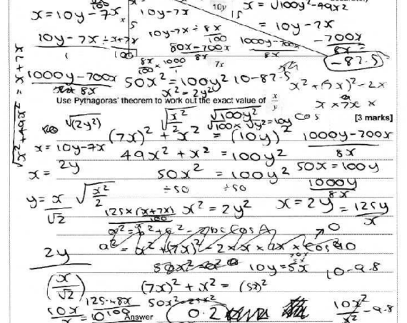
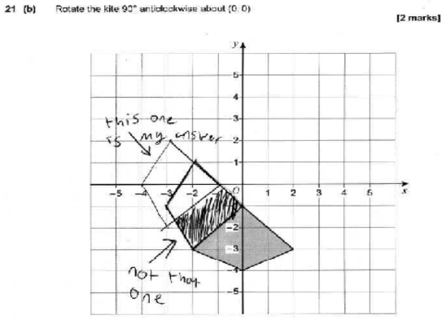

Slide 18
How the maths dept supports
Sparx maths help: every Friday lunchtime (T6/7)
After school revision sessions
Focus on exam practice in the Spring term (curriculum is normally complete by February half term)
How to revise for maths
How to problem solve
How to structure an answer
Provision and communication of personalized targets by topic
Autumn Term Maths Revision (3:30 – 4:30)
Tuesday​ (T6/7) | General GCSE Revision
​Wednesday (T7) | Targeting a Grade 8/9

Slide 19
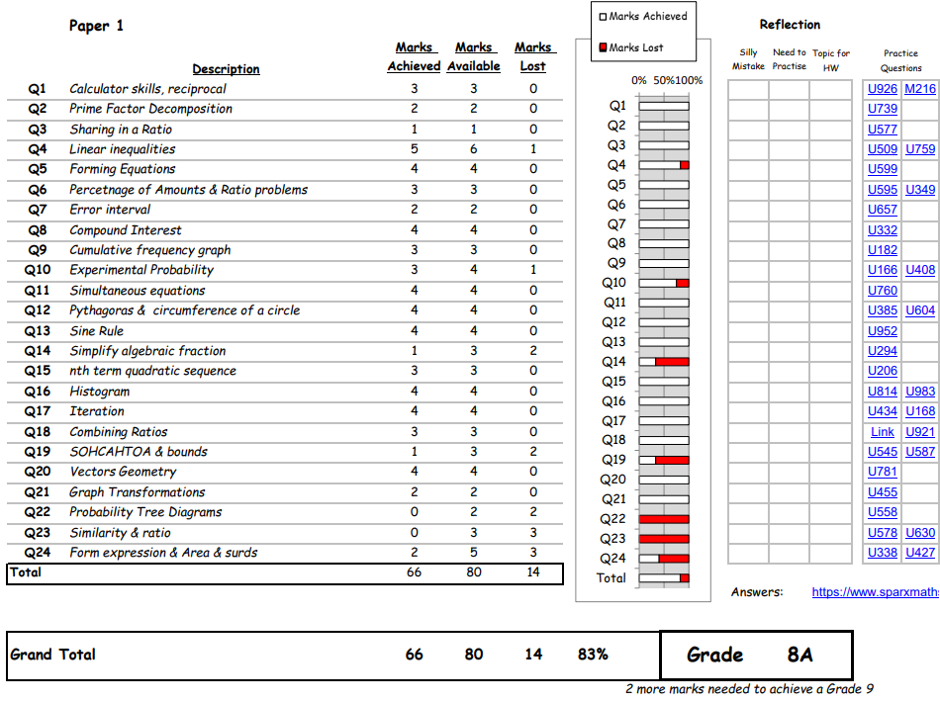

Slide 20
How the maths dept supports
Sparx maths help: every Friday lunchtime (T6/7)
After school revision sessions
Focus on exam practice in the Spring term (curriculum is normally complete by February half term)
How to revise for maths
How to problem solve
How to structure an answer
Provision and communication of personalized targets by topic
Answering questions: We encourage Perins students to communicate with their teachers!
Autumn Term Maths Revision (3:30 – 4:30)
Tuesday​ (T 6/7) | General GCSE Revision
​Wednesday (T7) | Targeting a Grade 8/9

Slide 21
Thank you
cholligan@perins.hants.sch.uk

Slide 22
SCIENCE
Year 11 Core Curriculum Evening
Perins School
2024

Slide 23
KEY GCSE DATES – 2025
Biology paper 1 13th May
Chemistry paper 1 19th May
Physics paper 1 22nd May
Biology paper 2 9th June
Chemistry paper 2 13th June
Physics paper 2 16th June

Slide 24
Separate Science Path – 3 Sciences
BIOLOGY | CHEMISTRY | PHYSICS
1. Cell Level Systems | 1. Particles | 1. Matter
2. Scaling up | 2. Elements and Bonding | 2. Forces
3. Organism Level Systems | 3. Chemical Reactions | 3. Electricity
4. Community Level systems | 4. Predicting Chemical Reactions | 4. Magnetism
5. Genetics | 5. Rate of Change | 5. Waves
6. Global Challenges | 6. Global Challenges | 6. Radioactivity
 |  | 7. Energy
 |  | 8. Global Challenges
50% of GCSE
50% of GCSE
50% of GCSE
50% of GCSE
Biology Paper 1 Units 1-3 105 minutes 90 marks | Chemistry Paper 1 Units 1-3 105 minutes 90 marks | Physics Paper 1 Units 1-4 105 minutes 90 marks
Biology Paper 2 Units 4-6 105 minutes 90 marks | Chemistry Paper 2 Units 4-6 105 minutes 90 marks | Physics Paper 2 Units 5-8 105 minutes 90 marks
50% of GCSE
50% of GCSE
50% of GCSE
50% of GCSE
50% of GCSE
50% of GCSE
50% of GCSE
Biology GCSE 1-9 | Chemistry GCSE 1-9 | Physics GCSE 1-9

Slide 25
Combined Science – 2 GCSE’s
BIOLOGY | CHEMISTRY | PHYSICS
1. Cell Level Systems | 1. Particles | 1. Matter
2. Scaling up | 2. Elements and Bonding | 2. Forces
3. Organism Level Systems | 3. Chemical Reactions | 3. Electricity and magnetism
4. Community Level systems | 4. Predicting Chemical Reactions | 4. Waves and Radioactivity
5. Genetics | 5. Rate of Change | 5. Energy
6. Global Challenges | 6. Global Challenges | 6. Global Challenges
16.7% of GCSE
16.7% of GCSE
Biology Paper 1 Units 1-3 70 minutes 60 marks | Chemistry Paper 1 Units 1-3 70 minutes 60 marks | Physics Paper 1 Units 1-3 70 minutes 60 marks
Biology Paper 2 Units 4-6 70 minutes 60 marks | Chemistry Paper 2 Units 4-6 70 minutes 60 marks | Physics Paper 2 Units 4-6 70 minutes 60 marks
16.7% of GCSE
16.7% of GCSE
16.7% of GCSE
16.7% of GCSE

Slide 26
Combined Science – 2 GCSE’s
BIOLOGY | CHEMISTRY | PHYSICS
1. Cell Level Systems | 1. Particles | 1. Matter
2. Scaling up | 2. Elements and Bonding | 2. Forces
3. Organism Level Systems | 3. Chemical Reactions | 3. Electricity and magnetism
4. Community Level systems | 4. Predicting Chemical Reactions | 4. Waves and Radioactivity
5. Genetics | 5. Rate of Change | 5. Energy
6. Global Challenges | 6. Global Challenges | 6. Global Challenges
2 GCSE’s eg:5-5, 6-5, 6-6 (U up to 9-9)

Slide 27
Maths in Science
density (kg/m³) = mass (kg)/volume (m³) | $$ρ=\frac{m}{V}$$
distance travelled (m) = speed (m/s) x time (s) | $$s=vt$$
acceleration (m/s²) = change in velocity (m/s)/time (s) | $$a=\frac{∆v}{t}$$
kinetic energy (J) = 0.5 x mass (kg) x (speed (m/s))² | $$E_{k}=\frac{1}{2}mv^{2}$$
force (N) = mass (kg) x acceleration (m/s²) | $$F=ma$$
momentum (kgm/s) = mass (kg) x velocity (m/s) | $$p=mv$$
work done (J) = force (N) x distance (m) (along the line of action of the force) | $$W=F∆s$$
power (W) = work done (J)/time(s) | $$P=\frac{W}{t}$$
force exerted by a spring (N) = extension (m) x spring constant (N/m) | $$F=k∆x$$
gravity force (N) = mass (kg) x gravitational field strength, g (N/kg) | $$W=mg$$
(in a gravity field) potential energy (J) = mass (kg) x height (m) x gravitational field strength, g (N/kg) | $$E_{p}=mgh$$
charge flow (C) = current (A) x time (s) | $$Q=It$$
potential difference (V) = current (A) x resistance (Ω) | $$V=IR$$
energy transferred (J) = charge (C) x potential difference (V) | $$E=QV$$
power (W) = potential difference (V) x current (A) = (current (A))² x resistance (Ω) | $$P=IV=I^{2}R$$
wave speed (m/s) = frequency (Hz) x wavelength (m) | $$v=fλ$$
efficiency = useful output energy transfer (J)/input energy transfer (J) | $$E_{f}=\frac{{∆E}_{u}}{∆E_{T}}$$
Equations
Unlike previous years, the equations are not provided…
Higher = 16 to recall and apply
Foundation = 15 to recall and apply
5/6 equations will be supplied – ‘Select and Apply’

Slide 28
Maths in Science
density (kg/m³) = mass (kg)/volume (m³) | $$ρ=\frac{m}{V}$$
distance travelled (m) = speed (m/s) x time (s) | $$s=vt$$
acceleration (m/s²) = change in velocity (m/s)/time (s) | $$a=\frac{∆v}{t}$$
kinetic energy (J) = 0.5 x mass (kg) x (speed (m/s))² | $$E_{k}=\frac{1}{2}mv^{2}$$
force (N) = mass (kg) x acceleration (m/s²) | $$F=ma$$
momentum (kgm/s) = mass (kg) x velocity (m/s) | $$p=mv$$
work done (J) = force (N) x distance (m) (along the line of action of the force) | $$W=F∆s$$
power (W) = work done (J)/time(s) | $$P=\frac{W}{t}$$
force exerted by a spring (N) = extension (m) x spring constant (N/m) | $$F=k∆x$$
gravity force (N) = mass (kg) x gravitational field strength, g (N/kg) | $$W=mg$$
(in a gravity field) potential energy (J) = mass (kg) x height (m) x gravitational field strength, g (N/kg) | $$E_{p}=mgh$$
charge flow (C) = current (A) x time (s) | $$Q=It$$
potential difference (V) = current (A) x resistance (Ω) | $$V=IR$$
energy transferred (J) = charge (C) x potential difference (V) | $$E=QV$$
power (W) = potential difference (V) x current (A) = (current (A))² x resistance (Ω) | $$P=IV=I^{2}R$$
wave speed (m/s) = frequency (Hz) x wavelength (m) | $$v=fλ$$
efficiency = useful output energy transfer (J)/input energy transfer (J) | $$E_{f}=\frac{{∆E}_{u}}{∆E_{T}}$$
Equations
All Physics equations will be given to students this year.
Biology and Chemistry equations are still to be learnt and applied

Slide 29
Maths in Science
Maths in Science
BIOLOGY | CHEMISTRY | PHYSICS | COMBINED SCIENCE
10% | 20% | 30% | 20% across all papers
Recognise and use expressions in standard form
Significant figures
Understand and use the symbols: =, <, <<, >>, >, ∝ , ~
Calculate areas of triangles and rectangles, surface areas and volumes of cubes
Draw and use the slope of a tangent to a curve as a measure of rate of change
Understand that y = mx + c represents a linear relationship
Make order of magnitude calculations

Slide 30
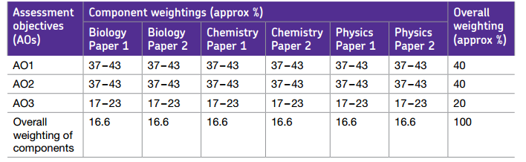
Components in Science
Assessment objectives (AOs) are set by Ofqual and are the same across all Science GCSE specifications and all exam boards. The exams will measure how students have achieved the following assessment objectives.
AO1: Demonstrate knowledge and understanding of: scientific ideas; scientific techniques and procedures.
AO2: Apply knowledge and understanding of: scientific ideas; scientific enquiry, techniques and procedures.
AO3: Analyse information and ideas to: interpret and evaluate; make judgements and draw conclusions; develop and improve experimental procedures.
AO1: RECALL
AO2: APPLICATION/UNSEEN INFOMRMATION
AO3: PRACTICAL SKILLS

Slide 31
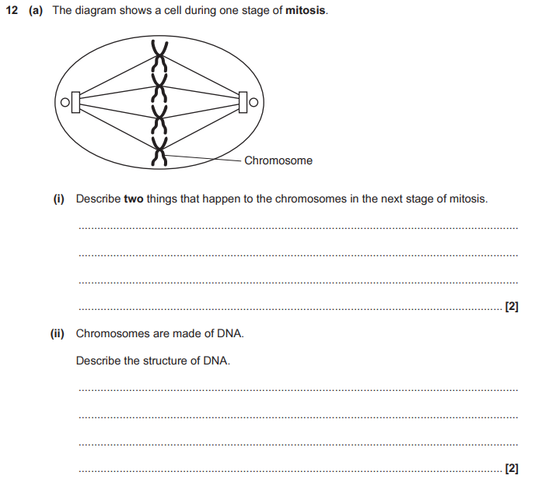
RECALL QUESTION
Notes:
Add in answers to pop up?

Slide 32
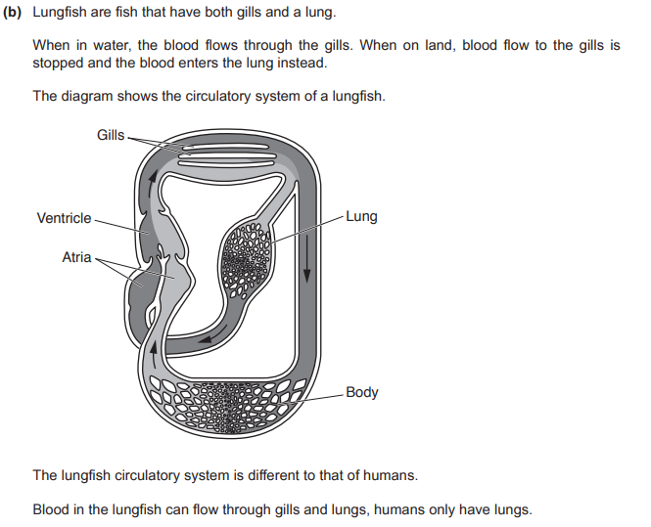
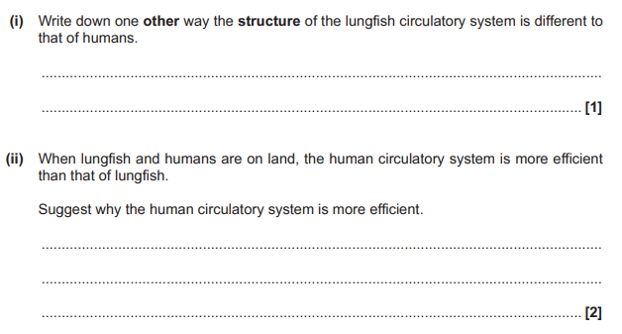
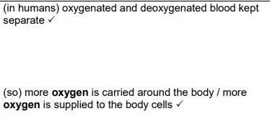
APPLY QUESTION

Slide 33
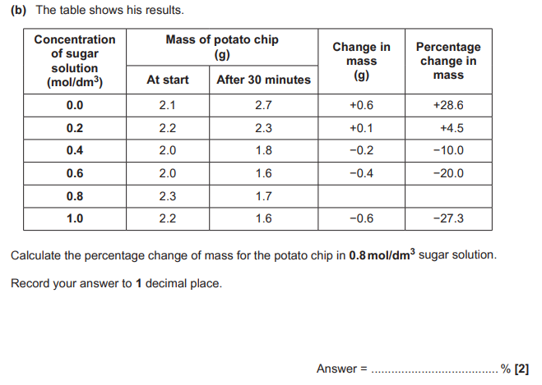
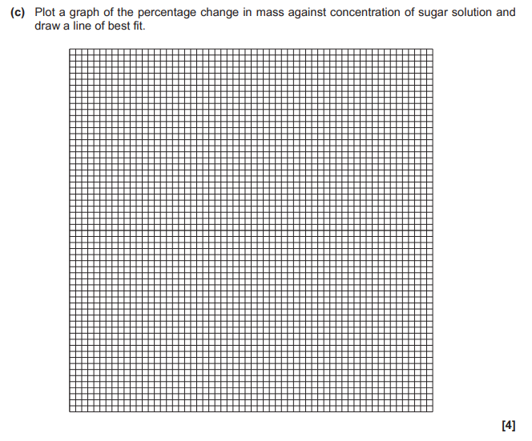
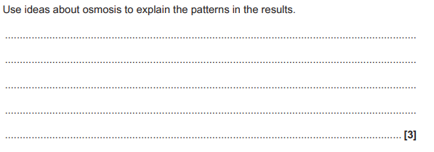
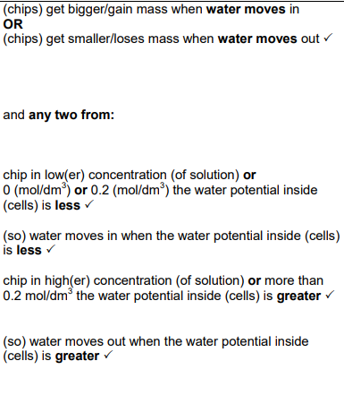
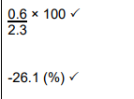
PRACTICAL SKILLS

Slide 34
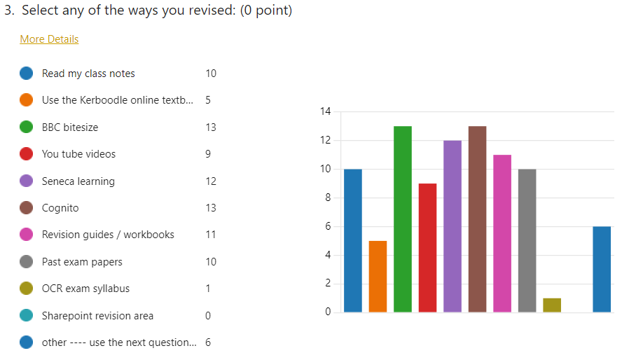
WHAT ARE STUDENTS DOING?

Slide 35
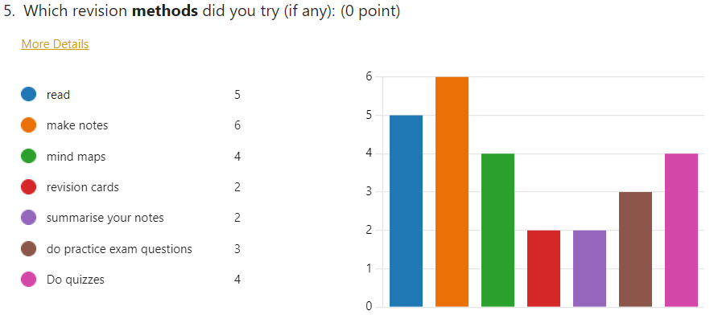
WHAT ARE STUDENTS DOING?

Slide 36
WHAT CAN YOU DO?

Slide 40
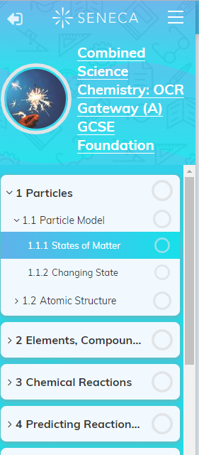
WHAT CAN YOU DO?

Slide 41
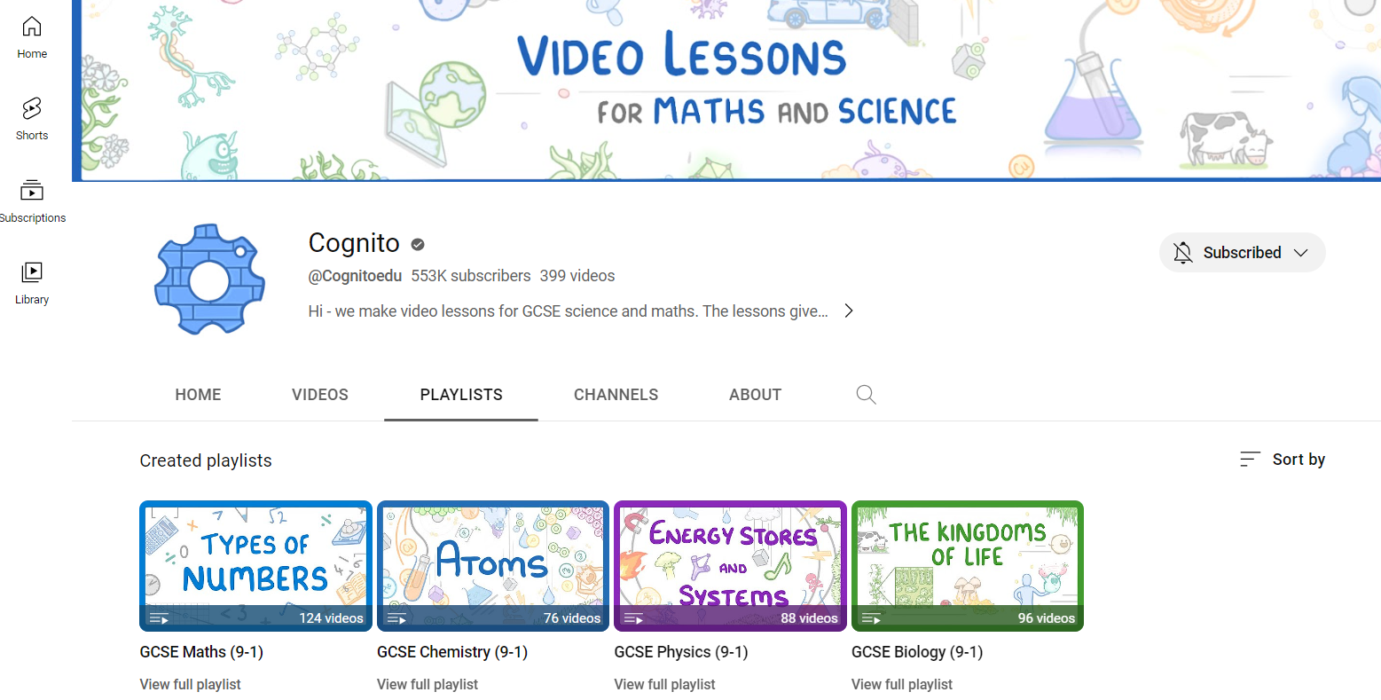
WHAT CAN YOU DO?

Slide 42
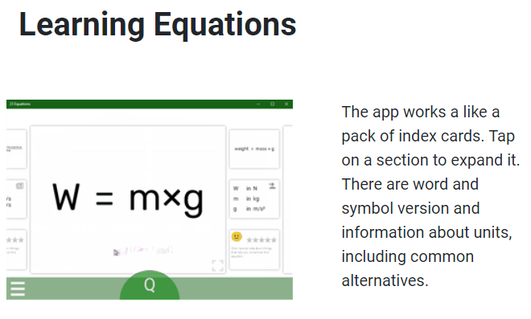
WHAT CAN YOU DO?

Slide 43
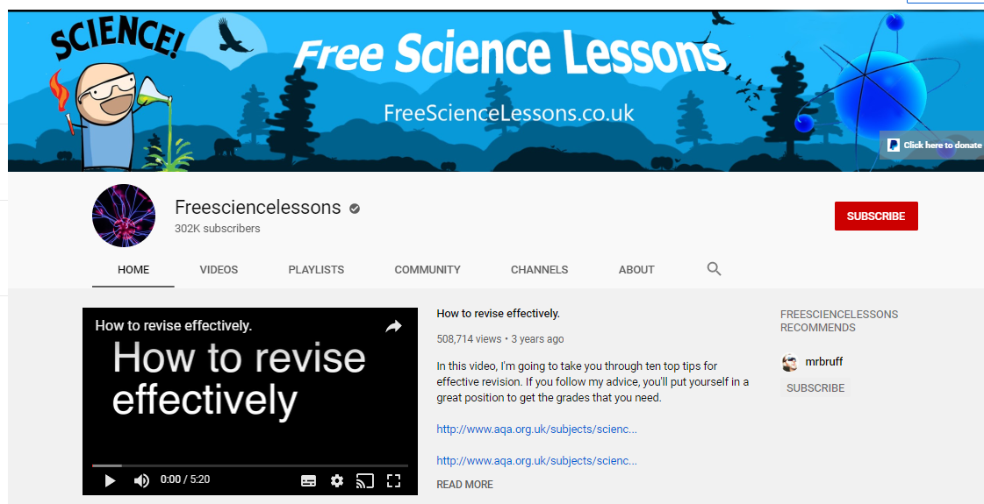
WHAT CAN YOU DO?

Slide 44
WHAT CAN YOU DO?
Encourage your child to prioritise their revision.
2. Encourage an environment where they can fully concentrate (no phones, music or distractions).
Notes:
I’ll bring an example of a checklist from Kerboodle ( 1 for each family)

Slide 45
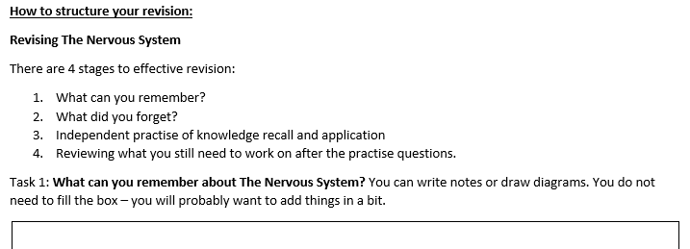
3. Reassure your child that revision isn’t easy. 20 minutes trying to recall something tricky, using a revision guide to check what they missed then testing themselves is MUCH more effective than an hour copying out notes.
Notes:
I’ll bring a 4 point plan (one for each family)

Slide 46
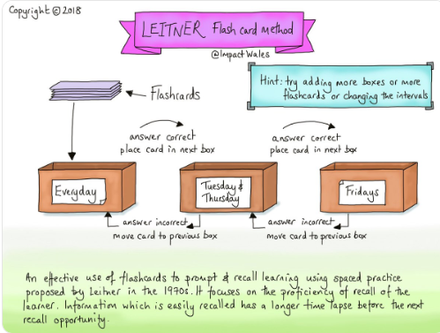
4. Ask your child what they have revised – get them to explain something to you. Ask if you can test them on some flashcards, get them talking about what they should learn.
Notes:
I’ll bring some flash cards to demo/get people to use.

Slide 47
Thank you!
cognito
23 Equations
freesciencelessons

Slide 48
Elevate

Slide 49
What this means for your child:
Fortnightly revision sessions throughout the year: a chance to create revision resources and plan their revision with guidance from teachers.
There will be consistent knowledge reviews and teaching of revision strategies in the lesson.
Elevate session on 7th October: targeted sessions delivered by Elevate (external company that specialise in exam preparation and revision).

Slide 50
Expectations for these lessons:
Students must take independence and look after their own revision resources and plans.
Students must take responsibility for bringing the expected resources and information with them.

Slide 51
What students may think:
It’s common to have beliefs such as ‘I can’t do it’ or ‘I am going to fail’.
These are just beliefs and not fact!
Let’s change that…

Slide 52
We need to reinforce a new belief:
Results are controllable for you and are a reflection of your input

Slide 53
Exam Planner
What tasks will you need to complete?
Which tasks do you already do that work?
Which tasks do you not do and will now commit to doing?
Decide on the first subject you would like to focus on
Now decide on your goal, for example:
Improve your mark by 10%
Be able to answer all questions in the paper
What is the deadline for each task?
What order will they need to be completed in?
For example, revision flash cards will need to be created early on and before completing practice papers
Status: tick this box when you feel confident that you have completed the task

Slide 54
Connect your
parent account
Notes:
Launched in early 2018 in the UK we now have over 6 million students and 350,000 teachers
With a mission to make a free and high quality education accessible to all
Seneca Learning is a free learning platform which offers curriculum specific content and interactive questions to keep students engage and improve learning outcomes
Seneca is an interactive platform that explains the information and concepts students need to know together with a variety of questions designed to improve their understanding.
Seneca courses are adaptive so students will see different questions depending on how the student has answered previous question, to give each student an individualised learning path.
This differentiation allows each student to study at their own pace and means that every learner irrespective of background or opportunity can use seneca for effective independent study.
To maximise engagement seneca uses different types of question and a variety of media to increase enjoyment and boost student participation whether students are in class or at home
As a teacher its easy to get started with Seneca so lets move on to the platform log in and take a tour.

Slide 55
Create a parent account
https://app.senecalearning.com/sign-up-parent

Slide 56
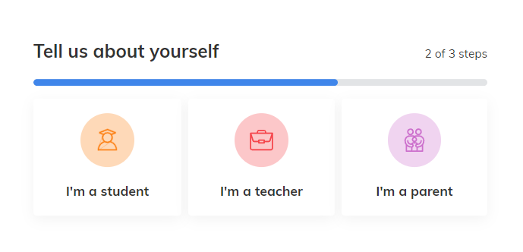
Tell us about yourself

Slide 57
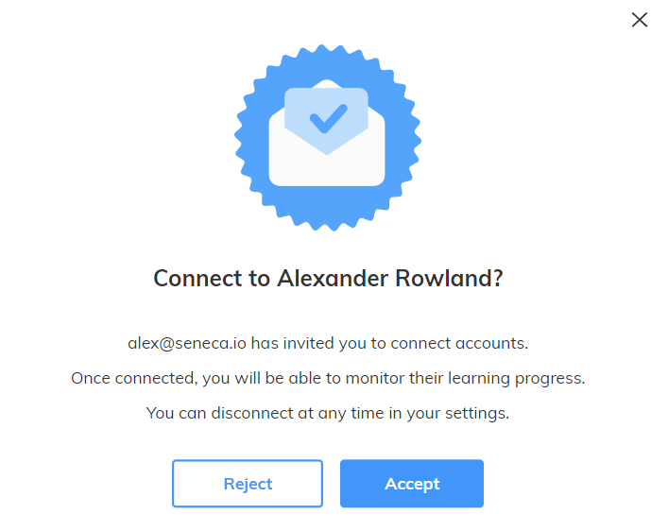
Accept the connection
Please note:
You will only be asked to automatically connected to your child if the email you used to sign up for Seneca is the email connected to your child's account in the school MIS system. Otherwise, skip to the last slide for instructions on how to connect to your child manually.

Slide 58
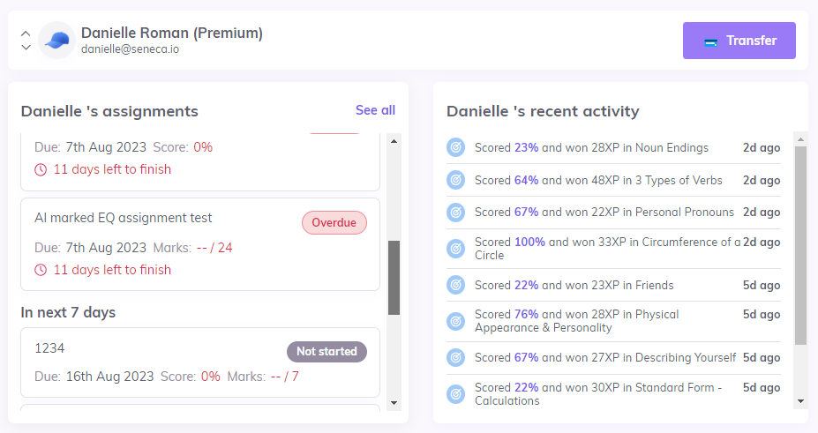
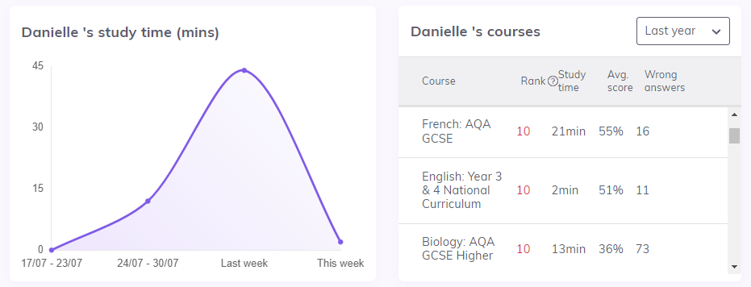
You are connected!

Slide 59
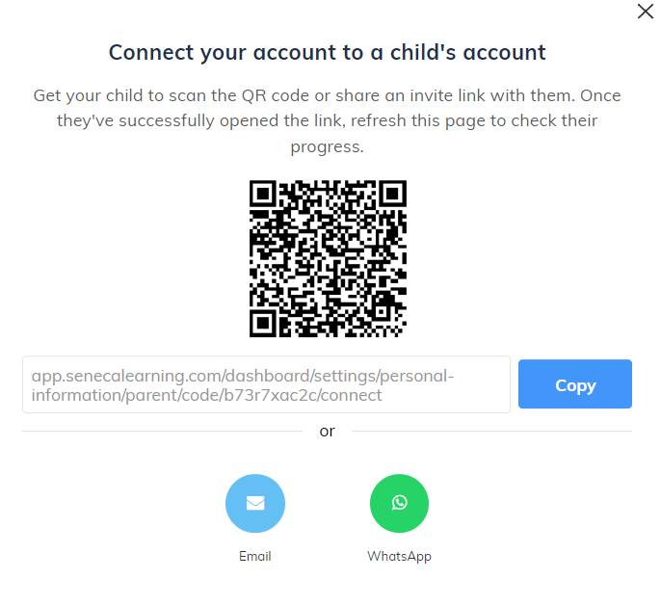
Connect your child’s account manually
Use one of these 2 options to manually connect your child:
From the parent account
Click “Add a child”
Copy and send the link to your child or ask your child to scan the QR code
From the child account
Ask your child to add you as a parent by entering the email you used to sign up for Seneca as a parent.

Slide 60
Thank you

