Slide 1
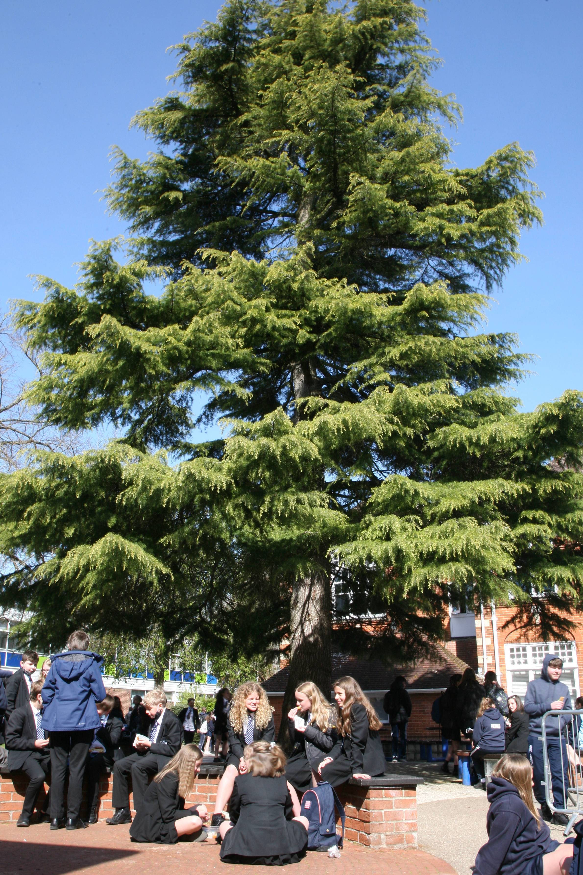

Year 8 Options
2026
Aspire
TODAY
Inspire
TOMORROW

Slide 2


Why make GCSE choices now?
Become more familiar with the soft skills necessary for GCSE exams.
More time for practical, creative and applied learning.
Reduces the stress of rushing through specifications and allows time to explore content in more depth.
Allows greater opportunity to practise and internalise metacognitive habits.
Aspire
TODAY
Inspire
TOMORROW

Slide 3
The Year 9 Curriculum
Aspire
TODAY
Inspire
TOMORROW

Slide 4
SUBJECTS – Core, non-examined
Core Physical Education
Four lessons per fortnight
Life Studies (Core PSHE)
Two lesson per fortnight in Year 9
Society & Beliefs (Core RE)
One lesson per fortnight
Aspire
TODAY
Inspire
TOMORROW

Slide 5
SUBJECTS – Core examined
English – English Language and English Literature (2 GCSEs)
Maths - Two calculator, and one non-calculator exam (1 GCSE)
Science – Combined Science (2 GCSEs) OR Separate Sciences (3 GCSEs)
In Year 9 all students will study the same material based on the Combined Science specification.
At the end of Year 9, trial exams, along with other assessment data will determine those students who will follow the separate science courses and those who will remain on the combined science course.
Aspire
TODAY
Inspire
TOMORROW

Slide 6
6 OPTIONS
OPTION 1
CHOOSE ANY SUBJECT
OPTION 2
CHOOSE ANY SUBJECT
OPTION 3
CHOOSE ANY SUBJECT
OPTION 4
CHOOSE ANY DIFFERENT SUBJECT
OPTION 5
CHOOSE ANY DIFFERENT SUBJECT
OPTION 6
CHOOSE ANY DIFFERENT SUBJECT
CATEGORY A
Geography
History
Religious Studies
CATEGORY B
Art & Design
Dance
Design & Technology
Drama
Food Technology
Music
Photography
CATEGORY C
French
Spanish
Art & Design
Business
Child Development
Computer Science
Dance
Design & Technology
Drama
Food Technology
French
Geography
History
Media Studies
Music
Photography
Physical Education
Religious Studies
Spanish
Sport Studies
Art & Design
Business
Child Development
Computer Science
Dance
Design & Technology
Drama
Food Technology
French
Geography
History
Media Studies
Music
Photography
Physical Education
Religious Studies
Spanish
Sport Studies
Art & Design
Business
Child Development
Computer Science
Dance
Design & Technology
Drama
Food Technology
French
Geography
History
Media Studies
Music
Photography
Physical Education
Religious Studies
Spanish
Sport Studies
Aspire
TODAY
Inspire
TOMORROW

Slide 7
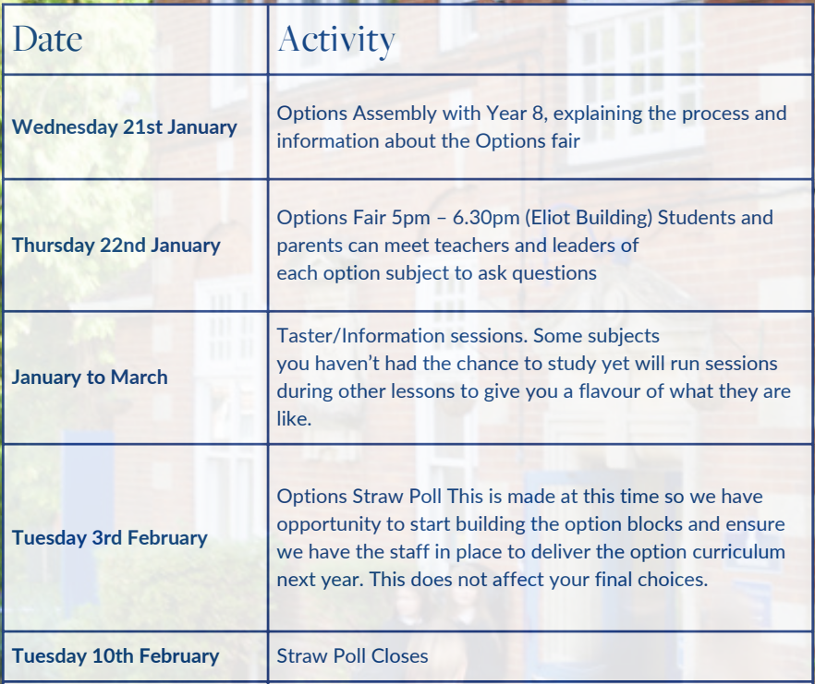
Timeline
Aspire
TODAY
Inspire
TOMORROW

Slide 8
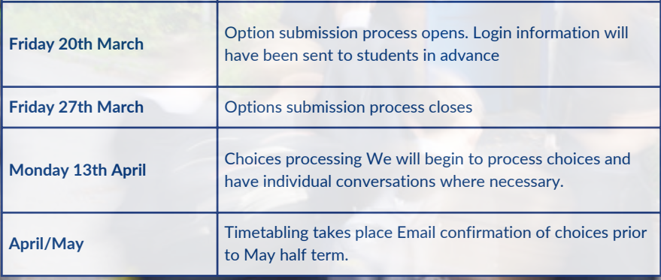
Timeline
Aspire
TODAY
Inspire
TOMORROW

Slide 9

On our website – advice to students
Aspire
TODAY
Inspire
TOMORROW

Slide 10
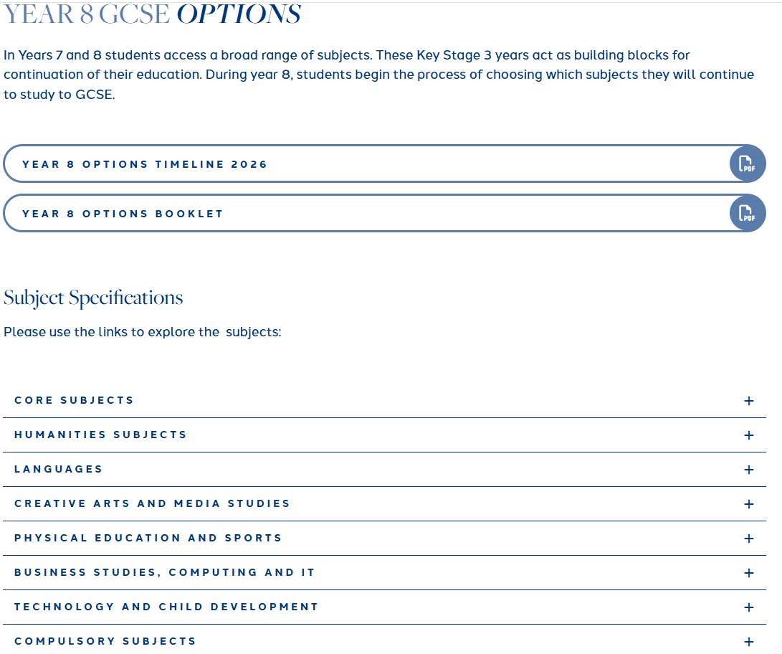
Title
Subtitle
Aspire
TODAY
Inspire
TOMORROW

Slide 11

Subject Specifications
Aspire
TODAY
Inspire
TOMORROW

Slide 12
What happens at the end of year 9?
You will choose 4 of your options to continue
This is not completely free choice (more on the next slide)
You should take into account: your progress, enjoyment, future study.
We will go through this process with you in the Spring of Y9.
Aspire
TODAY
Inspire
TOMORROW

Slide 13
4 OPTIONS
OPTION 1
CHOOSE ANY SUBJECT
OPTION 2
CHOOSE ANY SUBJECT
OPTION 3
CHOOSE ANY SUBJECT
OPTION 4
CHOOSE ANY DIFFERENT SUBJECT
OPTION 5
CHOOSE ANY DIFFERENT SUBJECT
OPTION 6
CHOOSE ANY DIFFERENT SUBJECT
CATEGORY A
Geography
History
Religious Studies
CATEGORY B
Art & Design
Dance
Design & Technology
Drama
Food Technology
Music
Photography
CATEGORY C
French
Spanish
Art & Design
Business
Child Development
Computer Science
Dance
Design & Technology
Drama
Food Technology
French
Geography
History
Media Studies
Music
Photography
Physical Education
Religious Studies
Spanish
Sport Studies
Art & Design
Business
Child Development
Computer Science
Dance
Design & Technology
Drama
Food Technology
French
Geography
History
Media Studies
Music
Photography
Physical Education
Religious Studies
Spanish
Sport Studies
Art & Design
Business
Child Development
Computer Science
Dance
Design & Technology
Drama
Food Technology
French
Geography
History
Media Studies
Music
Photography
Physical Education
Religious Studies
Spanish
Sport Studies
You must continue to have 2 out of your first 3 options
into year 10 and 11, meaning 2 of categories A, B & C
are included in your final four options
Aspire
TODAY
Inspire
TOMORROW

Slide 14
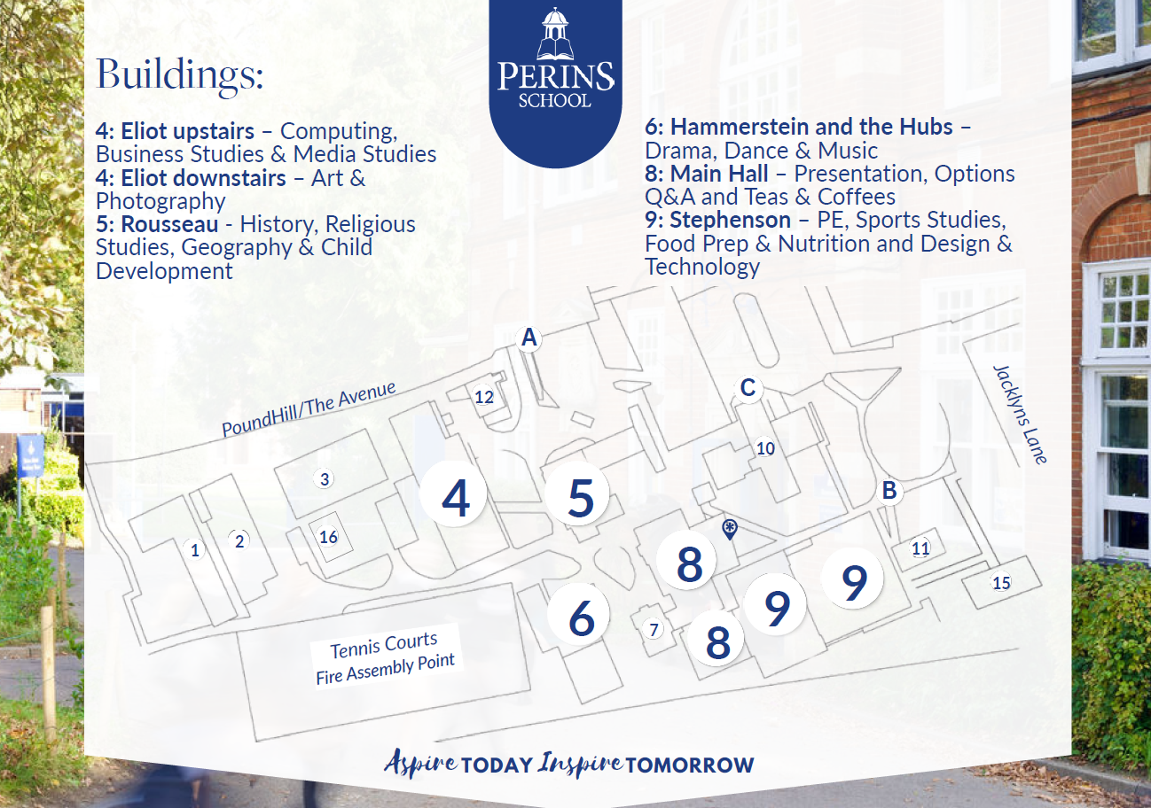
Map for this evening
Aspire
TODAY
Inspire
TOMORROW

Slide 15



Thank you
01962 734361
options@perins.hants.sch.uk
www.perins.net
Aspire
TODAY
Inspire
TOMORROW

