Slide 2
Outline
Tour company
Run down of draft itinerary
What is included/not included in Cost
Common Questions
Handout of key points of the presentation

Slide 3
The Travel Company

Slide 4
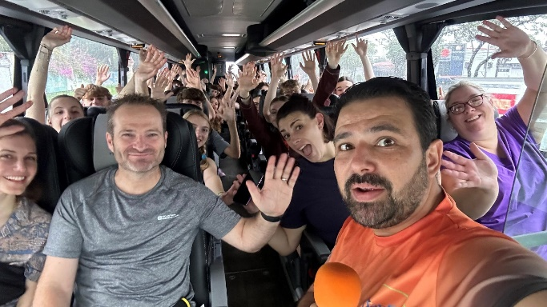
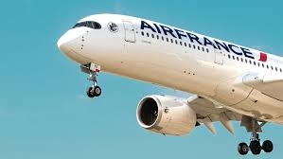
Day 1 Travel to San Jose

Slide 5
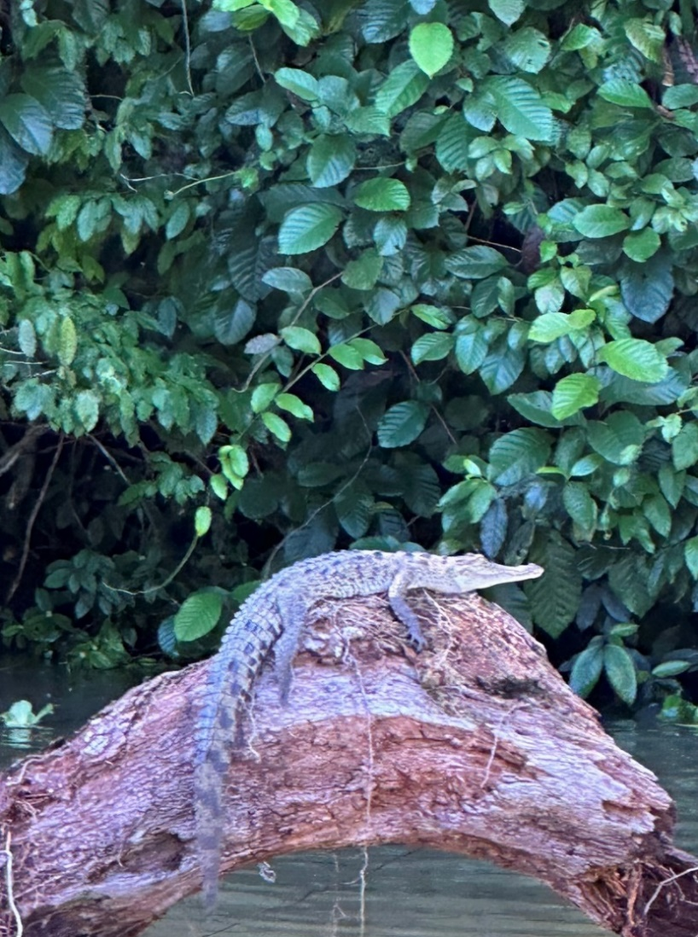
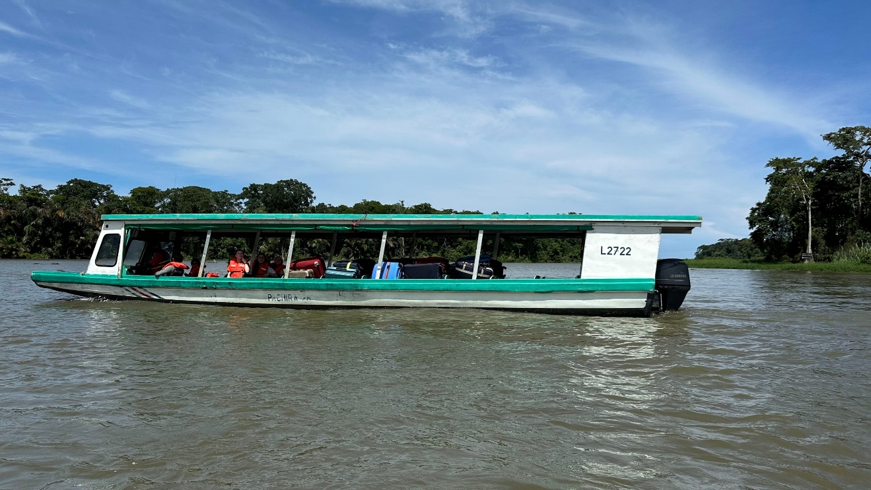
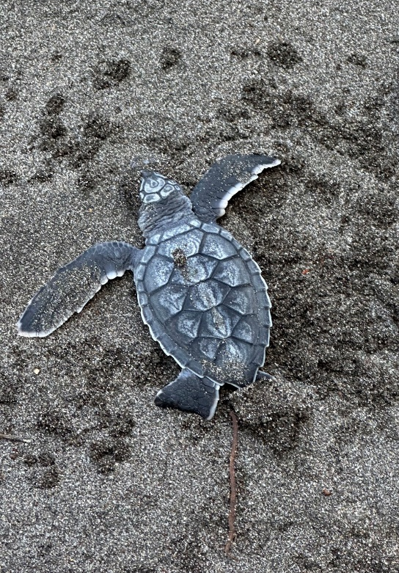
Day 2 San Jose to Tortuguero

Slide 6
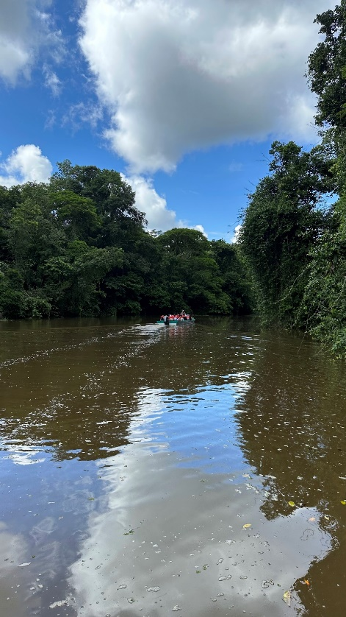
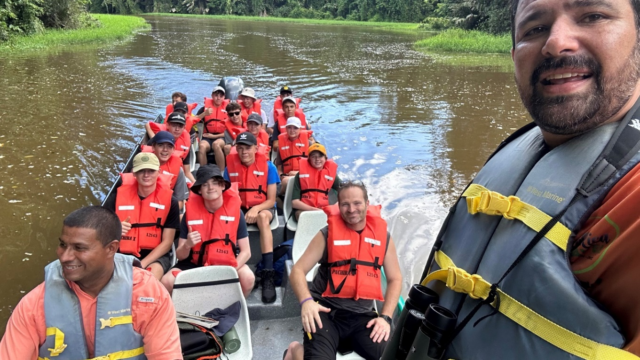
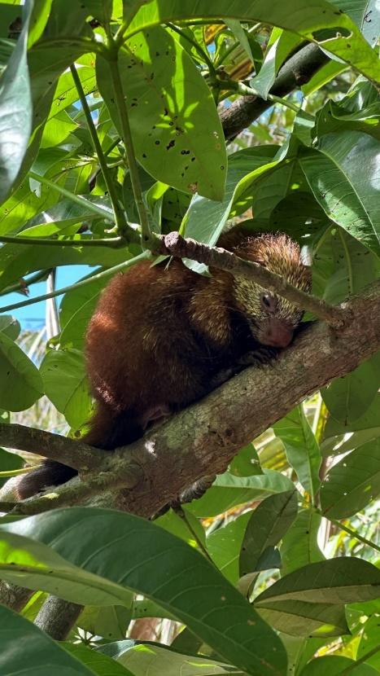
Day 3 Boat Excursion

Slide 7
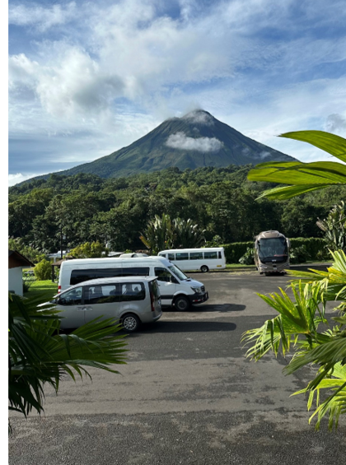
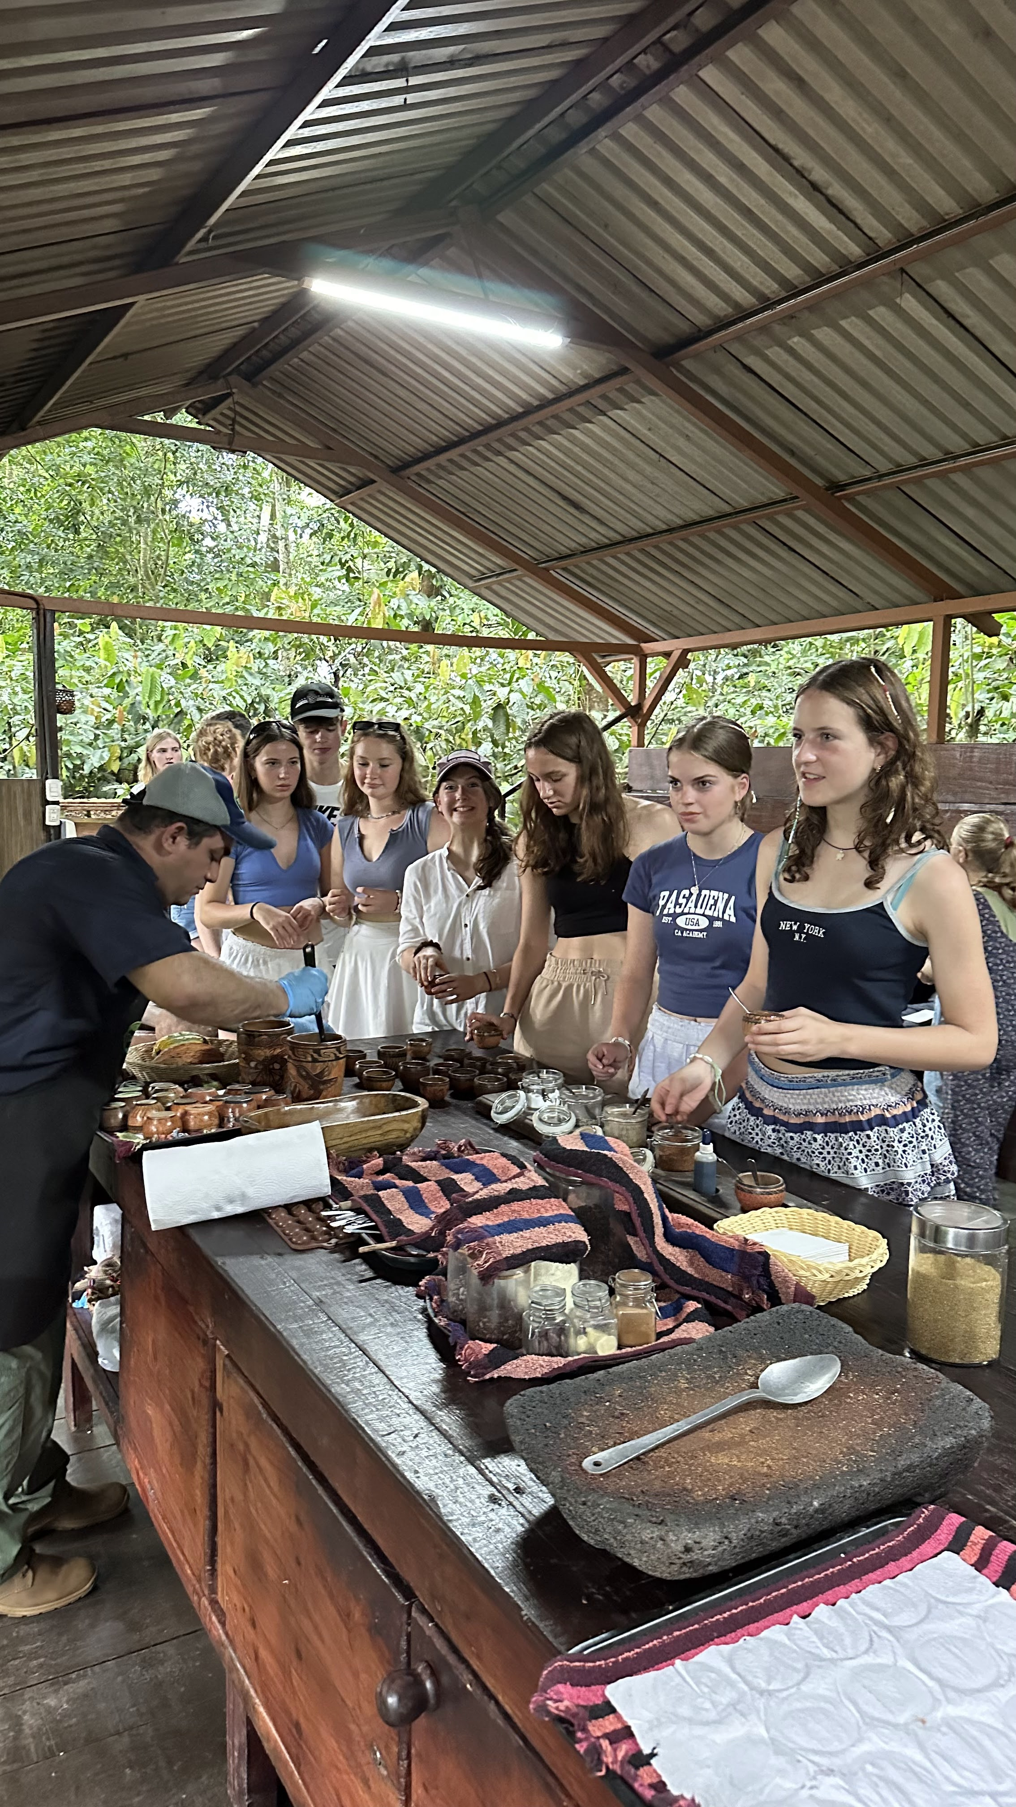
Day 4 Tortuguero to Arenal

Slide 8
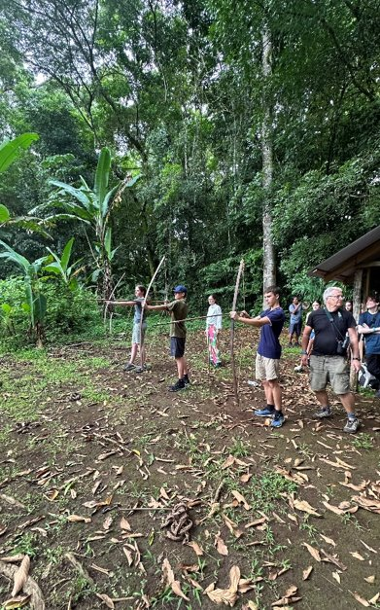
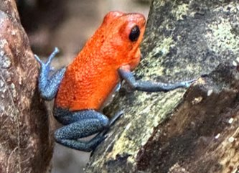
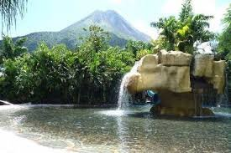
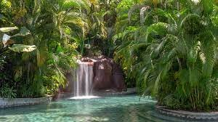
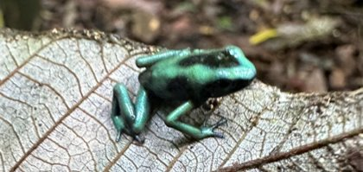
Day 5
Malekus Local Tribe and Hot springs

Slide 9
Day 6 Arenal to Monteverde

Slide 10
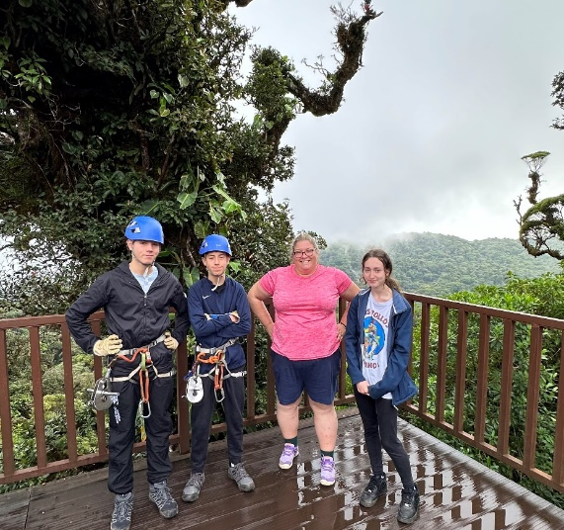
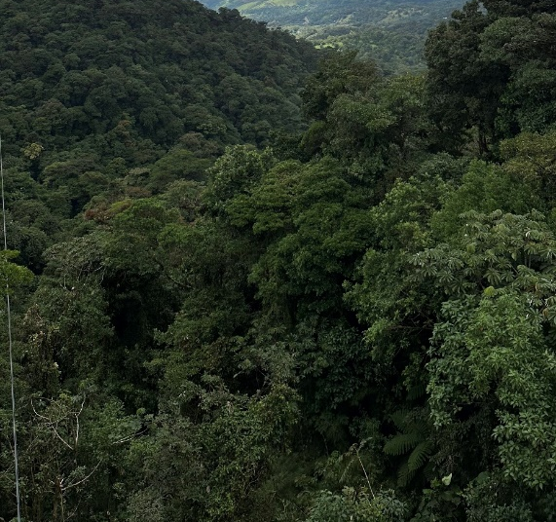
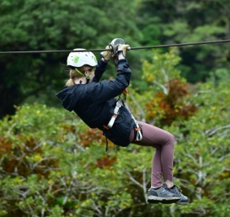
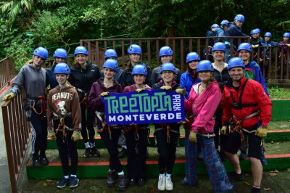
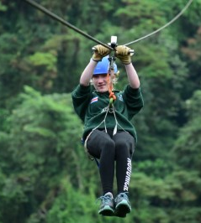
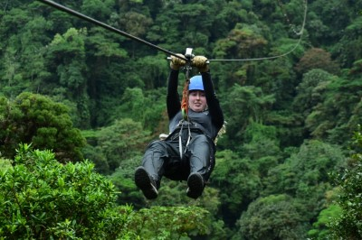
Day 7 Zip Lining

Slide 11
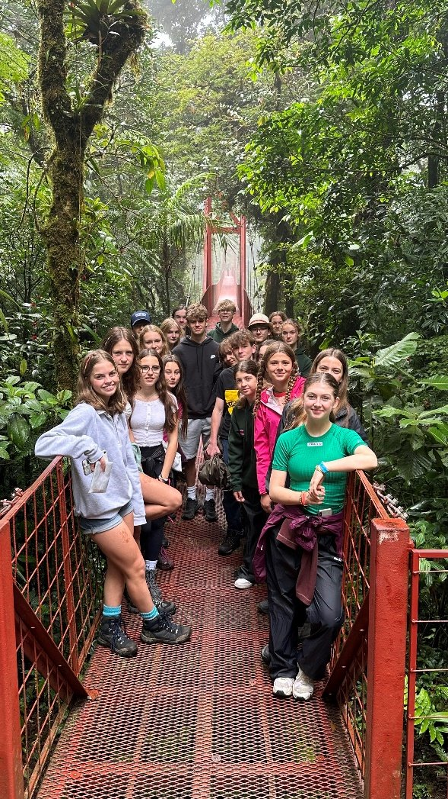
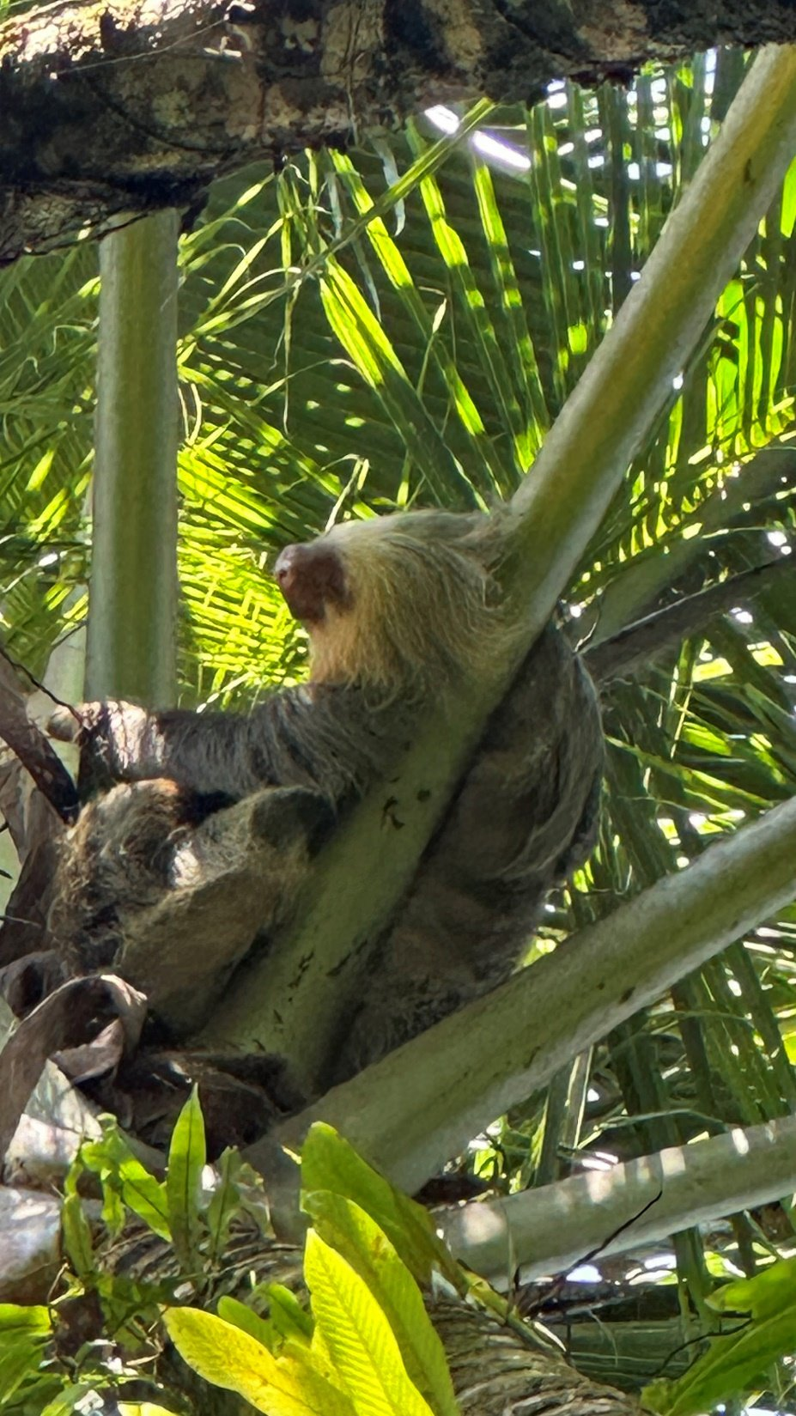
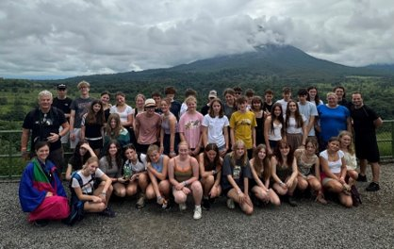
Day 8/9 Monteverde to San Jose & Home

Slide 12
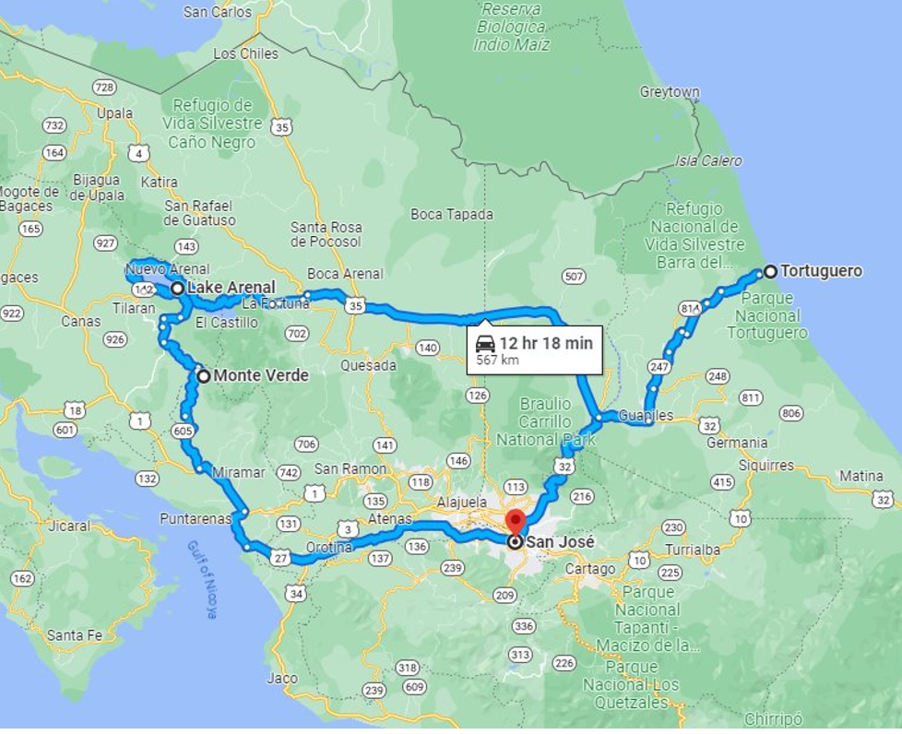
The Map

Slide 13
What’s Included
Airfares
Transport in Costa Rica
Accommodation
Food and Drink each day
Entry to all attractions
Guides
English speaking tour guide and driver

Slide 14
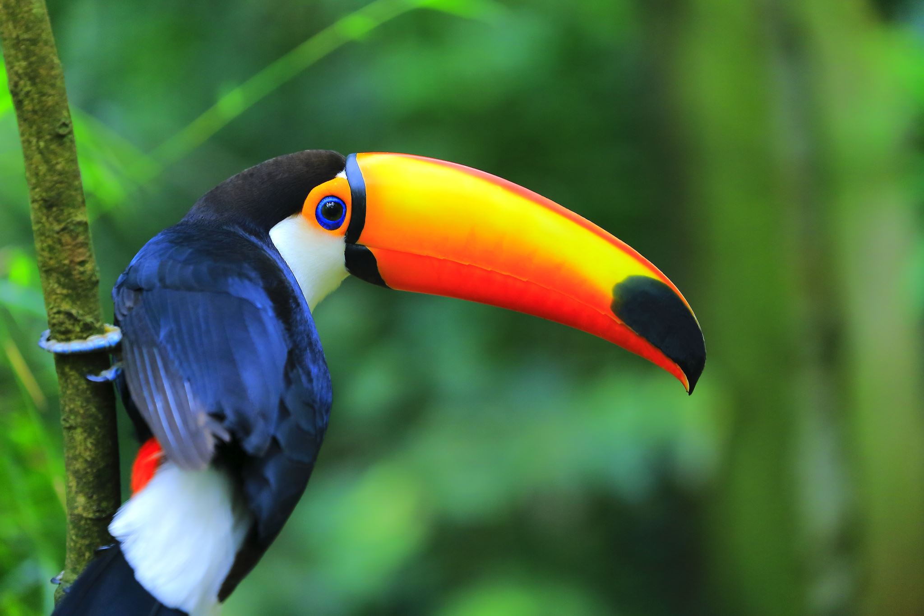
What’s not included
Transport to and from Heathrow - £25 approx.
Canada entry visa - £7 (if we fly air Canada) nothing by Air France
Final day meal - $20 US dollars
Food in airports/Snacks
Spending money (£10-15 per day) - optional
Tips for the guides (£20 per person approx.)
Tour Hoodie (or similar) - £25 – optional

Slide 15
COST
£2620 - £2725 – Under 16 at time of travel
With Extras (£72 approx.) – not incl hoodie/spending money
£2692 - £2797 Over 16
Price will depend on the final numbers (quote based on 30- 45 students)

Slide 16
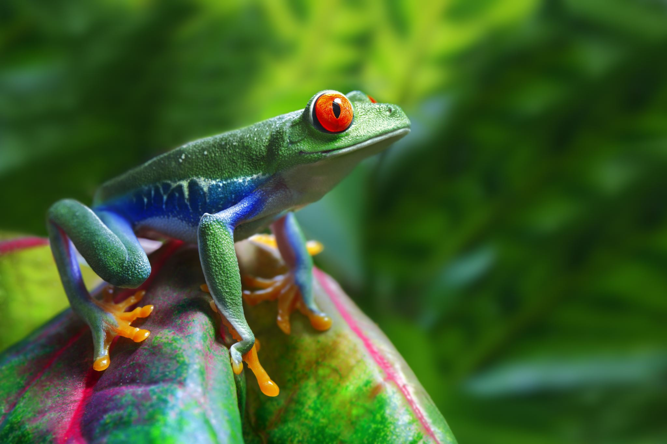
Common Questions
What is the food like?
What vaccinations do I need?
Passport nationalities
Is it safe?
What is the weather like?
Are there insects?
I get travel sickness
What about insurance?
How are you going to choose who goes?

Slide 17
Next Steps
Complete the form via QR code here (Will also be in the bulletin) by Friday 28th February
https://forms.office.com/e/TQ4NeSYaie
If selected – Will require a non-refundable £250 deposit
Payment schedule will be set up to have payments by July 2026

